Slide 1

Unit Testing in Android with GitHub Action
Teaching Assistants
Boston University
Apr. 15th, 2025

Slide 2
Outline
Previously: Google Test for C++
Today: Unit Testing in Android
Unit Testing Constraints
Test Suits with GitHub Actions
Code Merging after Passing Unit Testing
Weather Demo Unit Testing
Takeaways

Slide 3
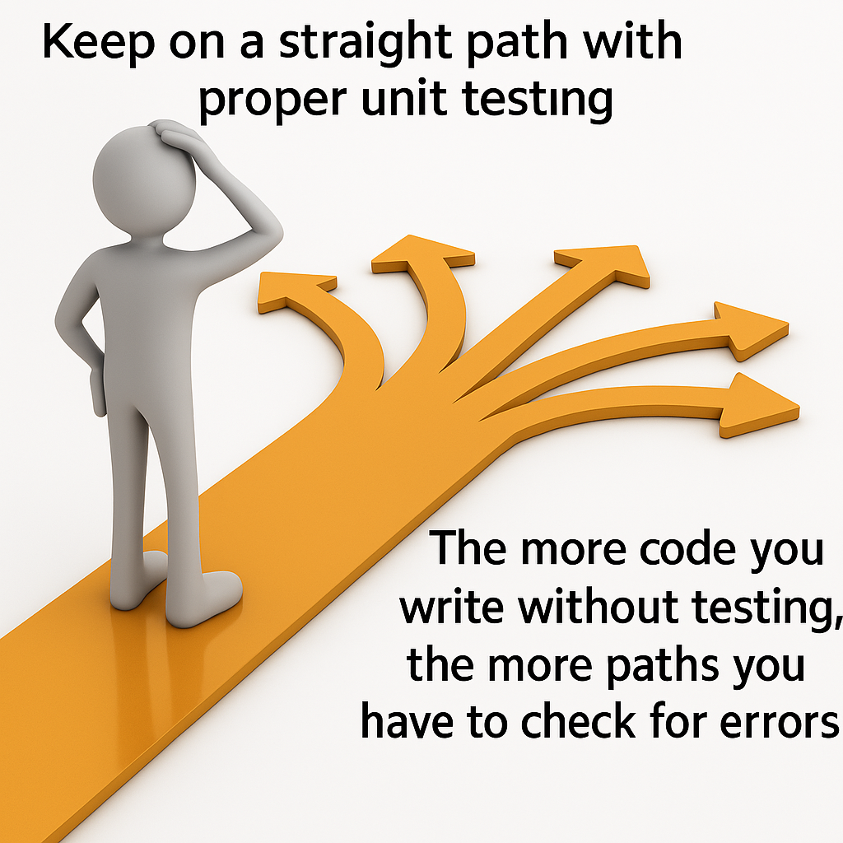
Part 1 ー Previously: Google Test (gtest) for C++
Ensuring that 'the thing' does what it is supposed to do
Credits: Introduction to Google Test: An Open Source C/C++ Unit-Testing Framework

Slide 4
Part 1 ー Previously: Google Test (gtest) for C++
An Open Source C/C++ Unit-Testing Framework
Ensuring that 'the thing' does what it is supposed to do
Tests should be independent and repeatable.
Tests should be well organized and reflect the structure of the tested code.
Tests should be portable and reusable.
Some example codes: Android-Unit-Testing/tree/main/GoogleTest/tests
Credits: Introduction to Google Test: An Open Source C/C++ Unit-Testing Framework

Slide 5
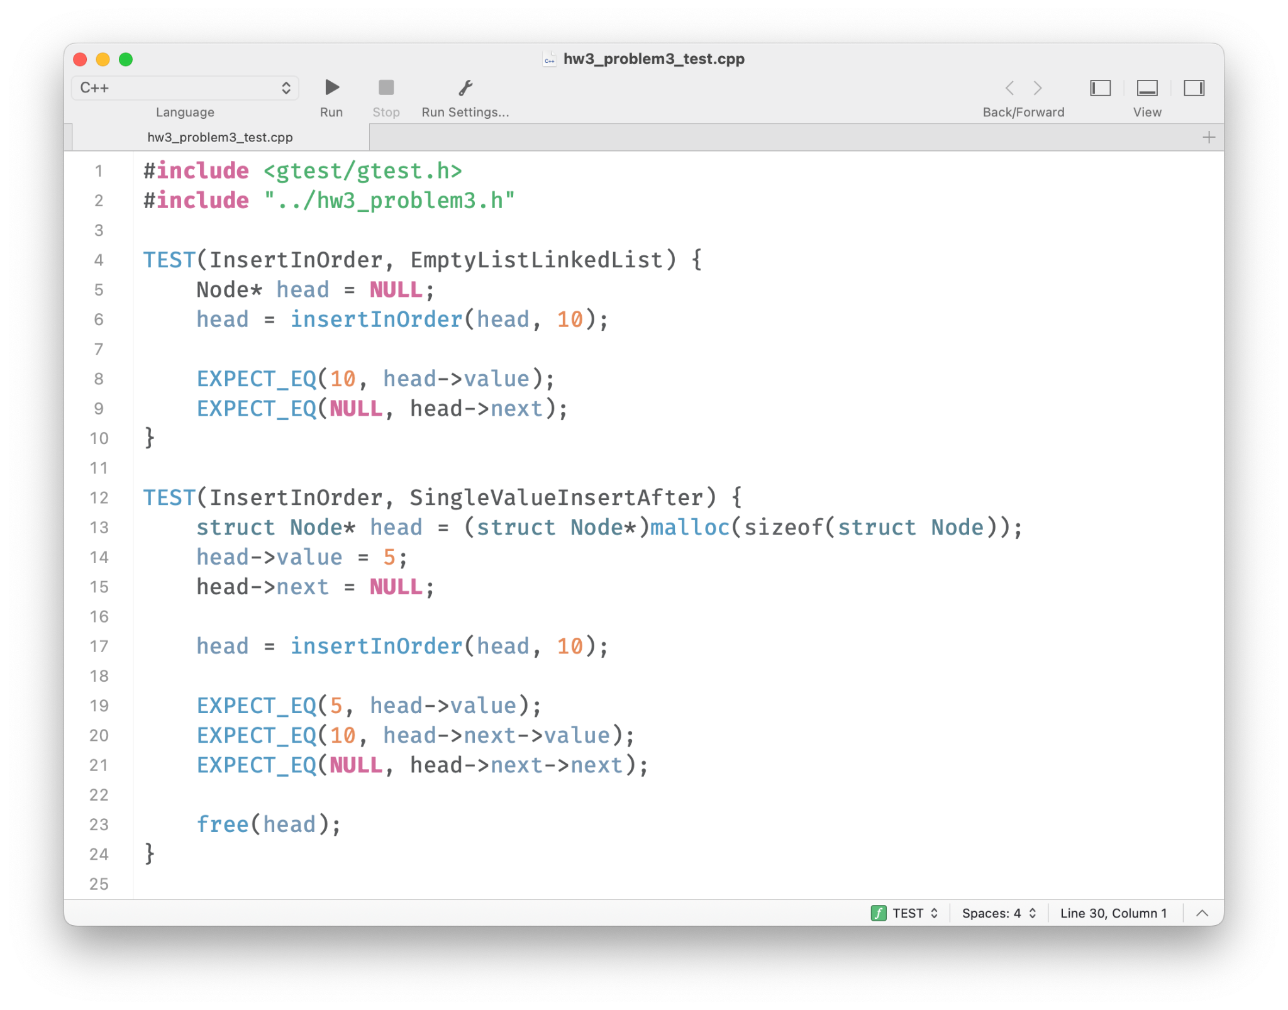
Part 1 ー Previously: Google Test (gtest) for C++
TEST(TestSuiteName, TestName) {
...
EXPECT_TRUE(DoSomething(GetParam()));
...
}
Credits: https://google.github.io/googletest/primer.html

Slide 6
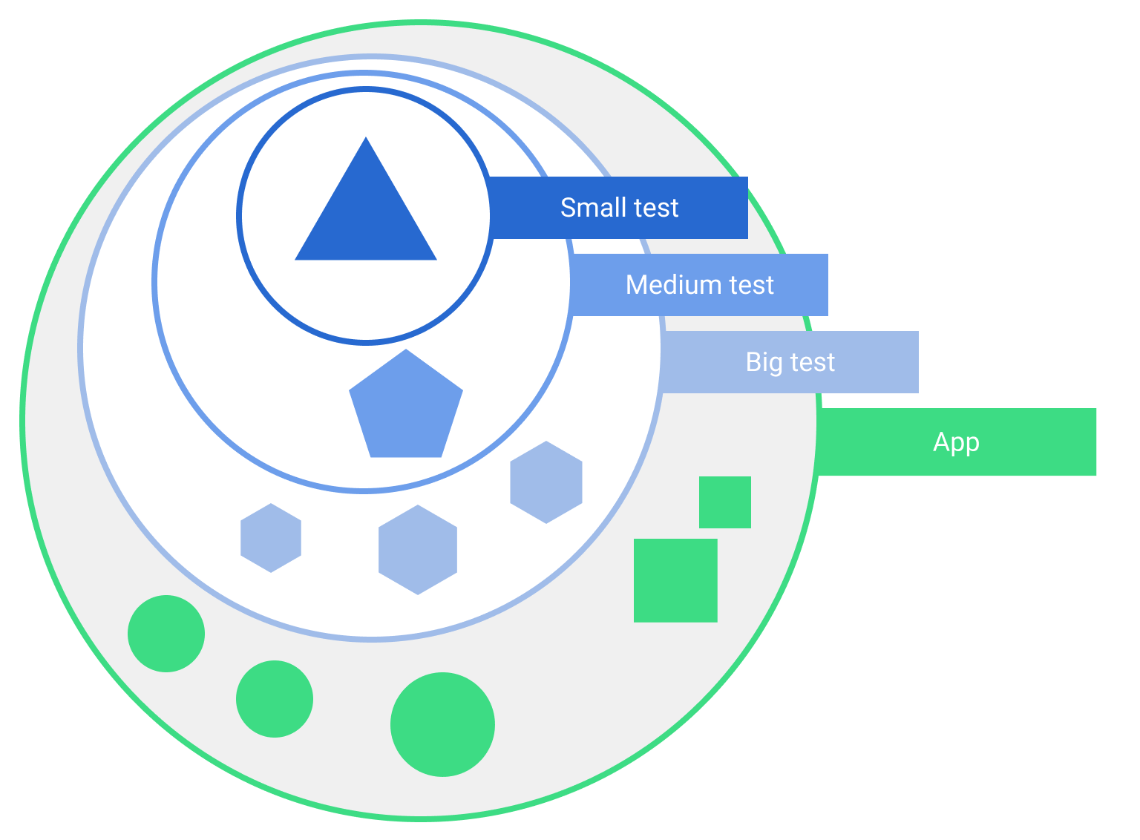
Part 2 ー Today: Unit Testing in Android
We are here today!
Test scopes in a typical application.
Credits: Fundamentals of testing Android apps
Notes:
Tests also vary depending on size, or degree of isolation:
Unit tests or small tests only verify a very small portion of the app, such as a method or class.
End-to-end tests or big tests verify larger parts of the app at the same time, such as a whole screen or user flow.
Medium tests are in between and check the integration between two or more units.

Slide 7
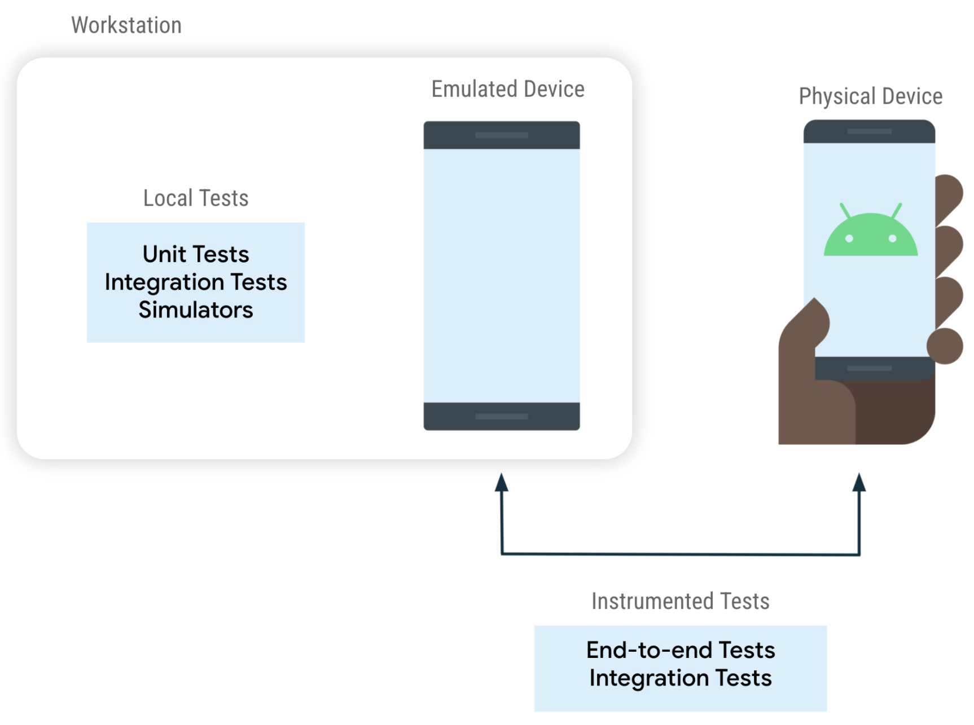
Part 2 ー Today: Unit Testing in Android
Android Studio
Credits: Fundamentals of testing Android apps
Different types of tests depending on where they run.
Notes:
Tests also vary depending on size, or degree of isolation:
Unit tests or small tests only verify a very small portion of the app, such as a method or class.
End-to-end tests or big tests verify larger parts of the app at the same time, such as a whole screen or user flow.
Medium tests are in between and check the integration between two or more units.

Slide 8

Part 2 ー Today: Unit Testing in Android
A type of software testing where individual units/components of a software are tested
Done during the development of an application
The objective of Unit Testing is to verify its correctness
Usually performed by the developer
Tools that we use in Android: JUnit

Slide 9
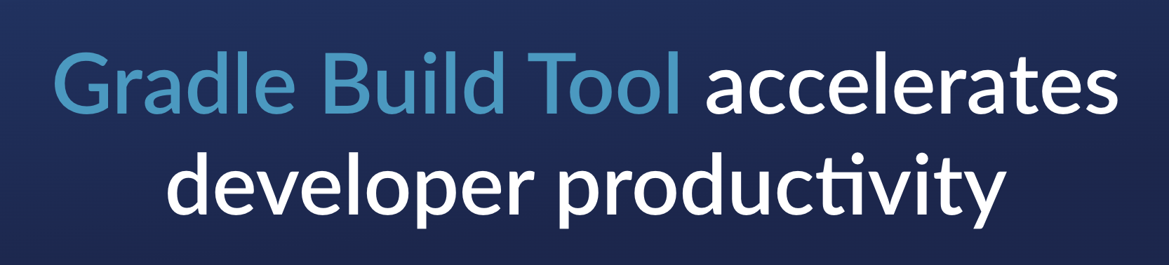
Part 2 ー Today: Unit Testing in Android
Tools that we use in Android: JUnit4
A programmer-oriented testing framework for Java.
By default, we will use Gradle Build Tool
Credits: https://github.com/junit-team/junit4/wiki/Use-with-Gradle

Slide 10
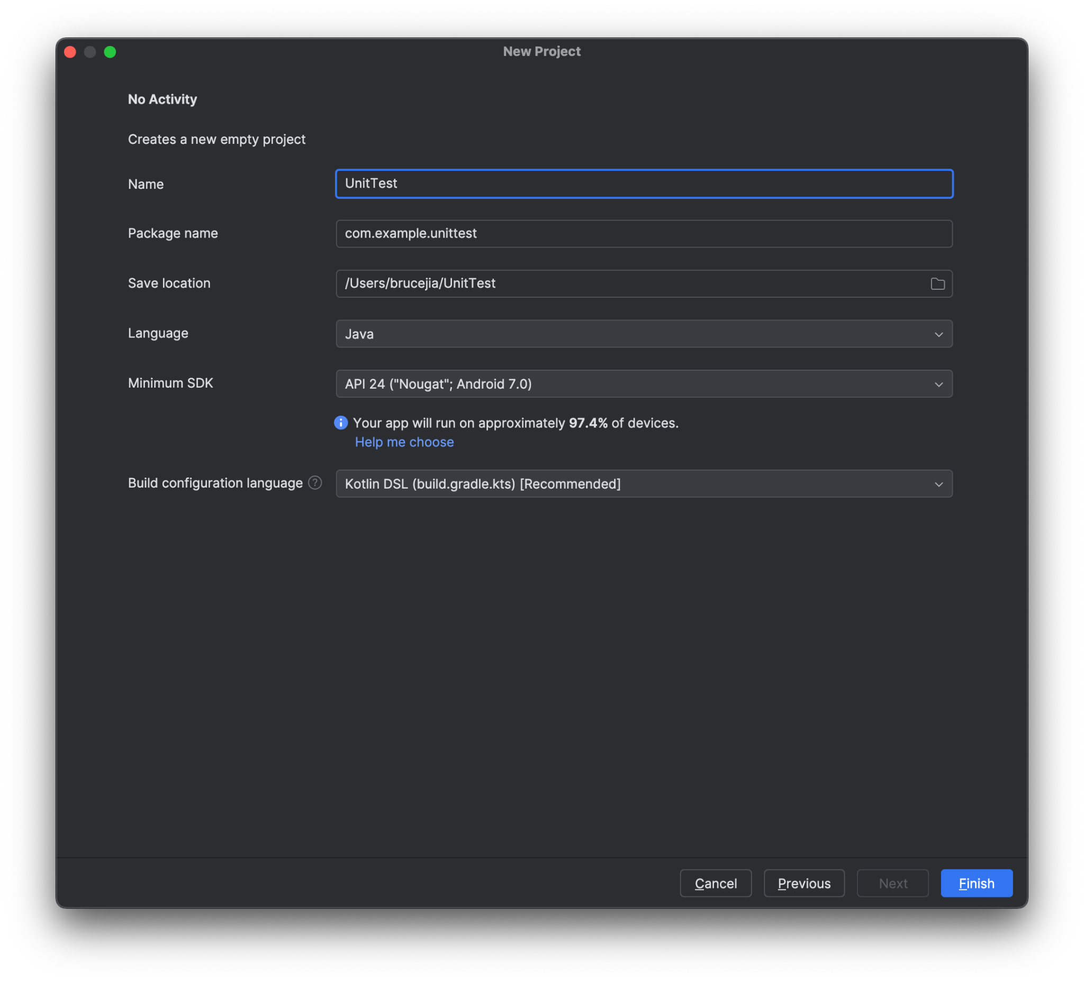
Part 2 ー Today: Unit Testing in Android
Create a new project called UnitTest
Credits: https://github.com/junit-team/junit4/wiki/Use-with-Gradle

Slide 11
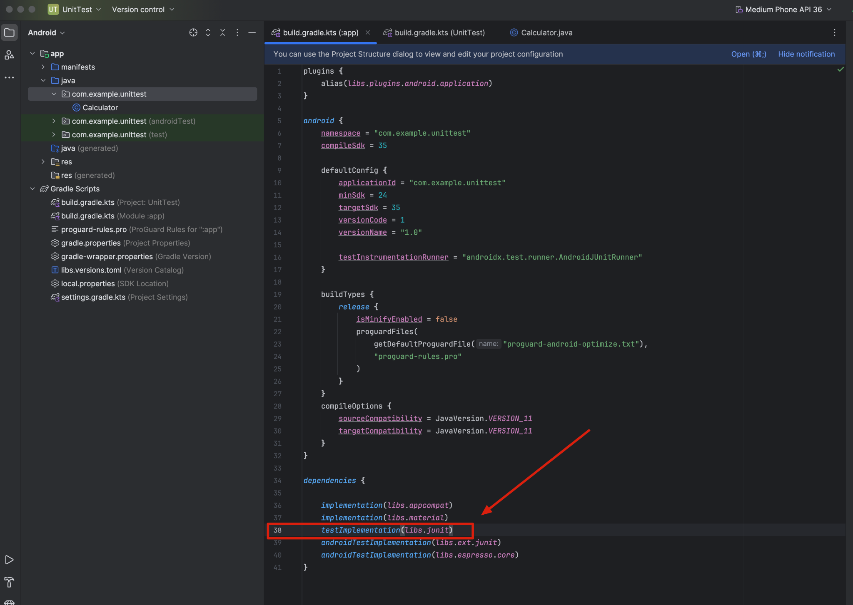
Part 2 ー Today: Unit Testing in Android
Under the build.gradle.kts (Module :app)
Credits: https://github.com/junit-team/junit4/wiki/Use-with-Gradle

Slide 12
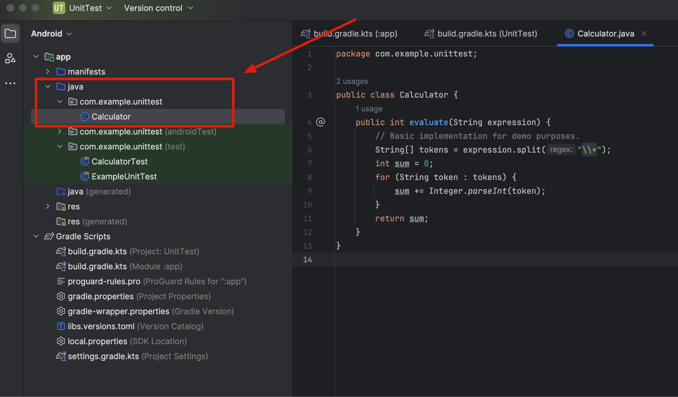
Part 2 ー Today: Unit Testing in Android
Create a JAVA class Calculator.java
under the src/androidTest/java/com/example/unittest folder
Credits: https://github.com/junit-team/junit4/wiki/Use-with-Gradle

Slide 13
Part 2 ー Today: Unit Testing in Android
package com.example.unittest;
public class Calculator {
public int evaluate(String expression) {
// Basic implementation for demo purposes.
String[] tokens = expression.split("\\+");
int sum = 0;
for (String token : tokens) {
sum += Integer.parseInt(token);
}
return sum;
}
}
Credits: https://github.com/junit-team/junit4/wiki/Use-with-Gradle

Slide 14
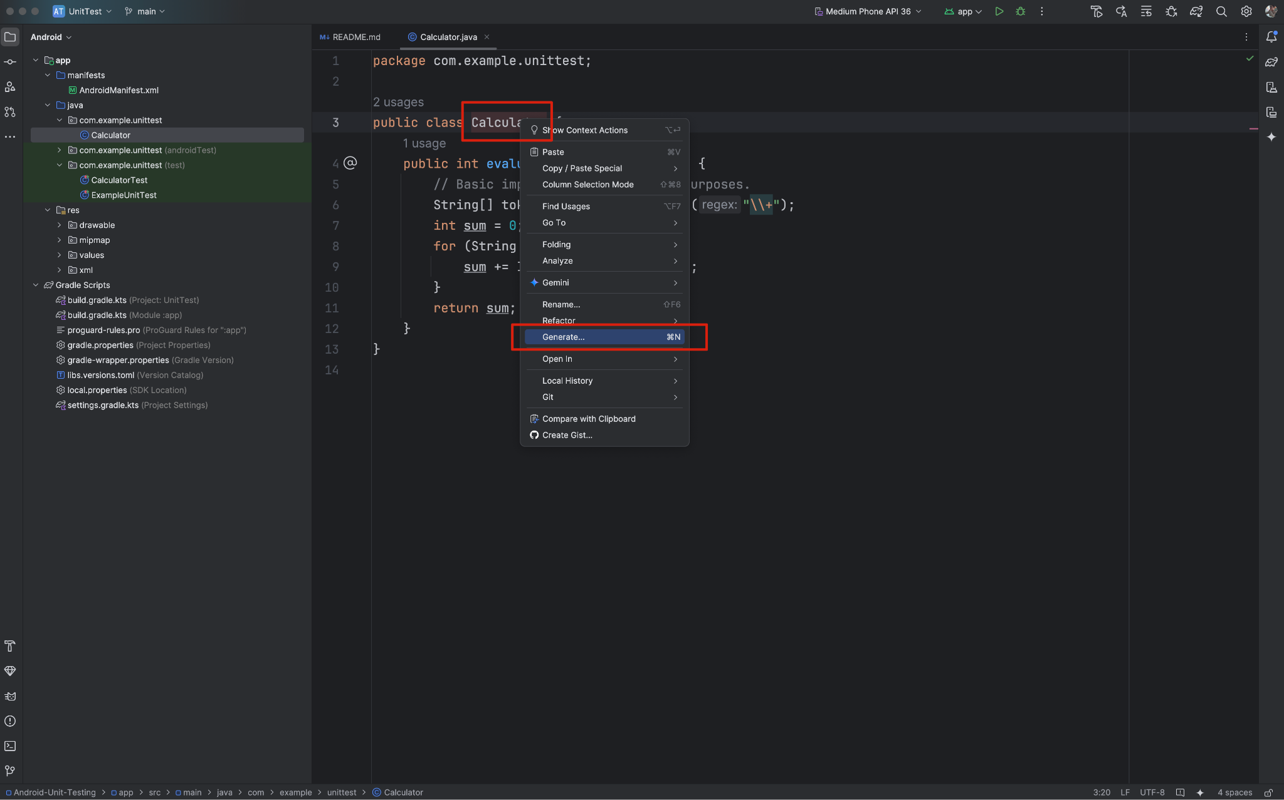
Part 2 ー Today: Unit Testing in Android
right click on the Class name and choose "Generate -> Test" and the boilerplate of the test will be generated in the correct place
Credits: https://github.com/junit-team/junit4/wiki/Use-with-Gradle

Slide 15
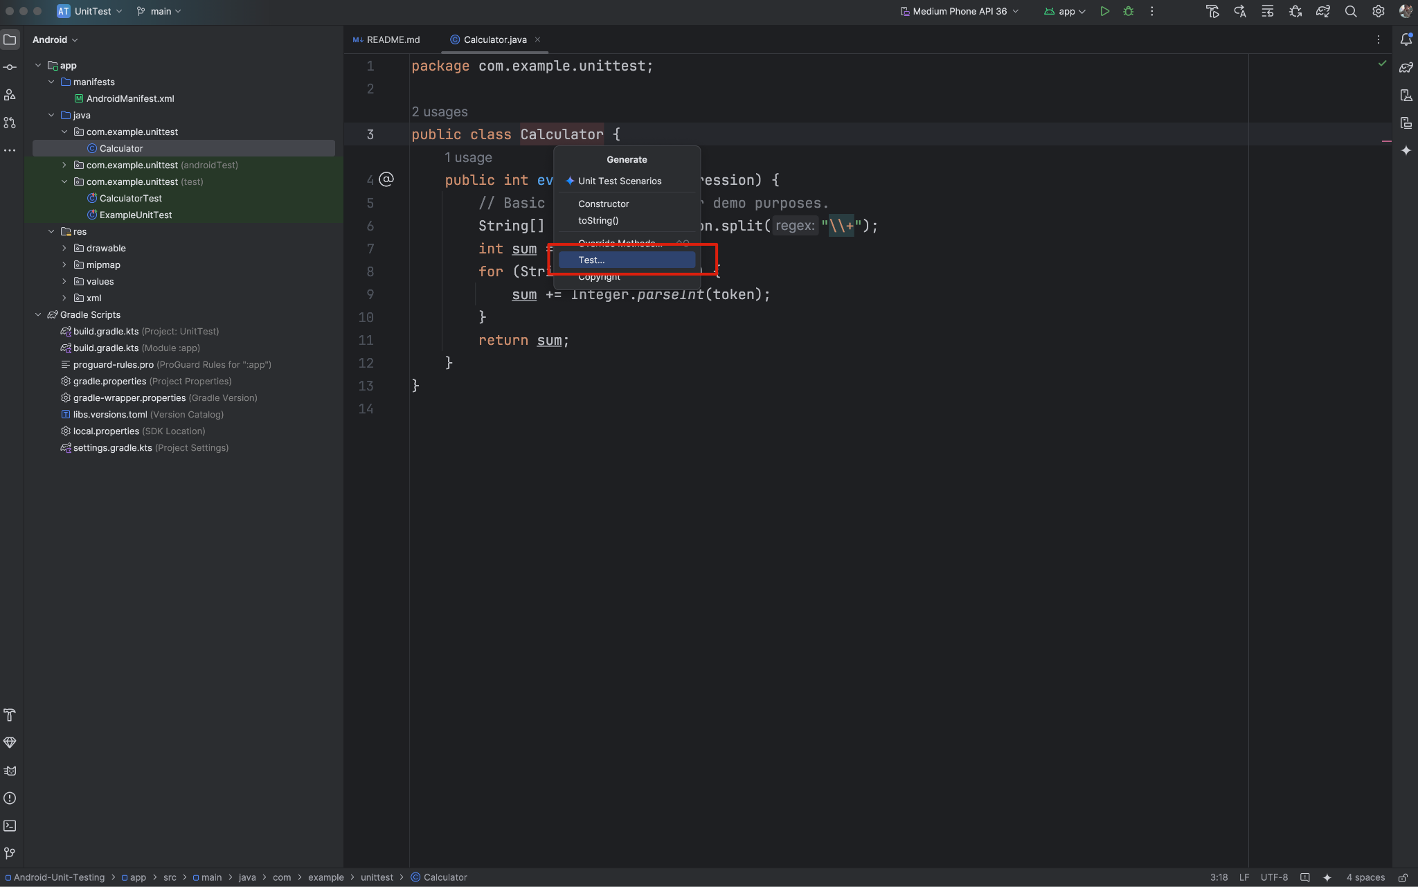
Part 2 ー Today: Unit Testing in Android
right click on the Class name and choose "Generate -> Test" and the boilerplate of the test will be generated in the correct place
Credits: https://github.com/junit-team/junit4/wiki/Use-with-Gradle

Slide 16
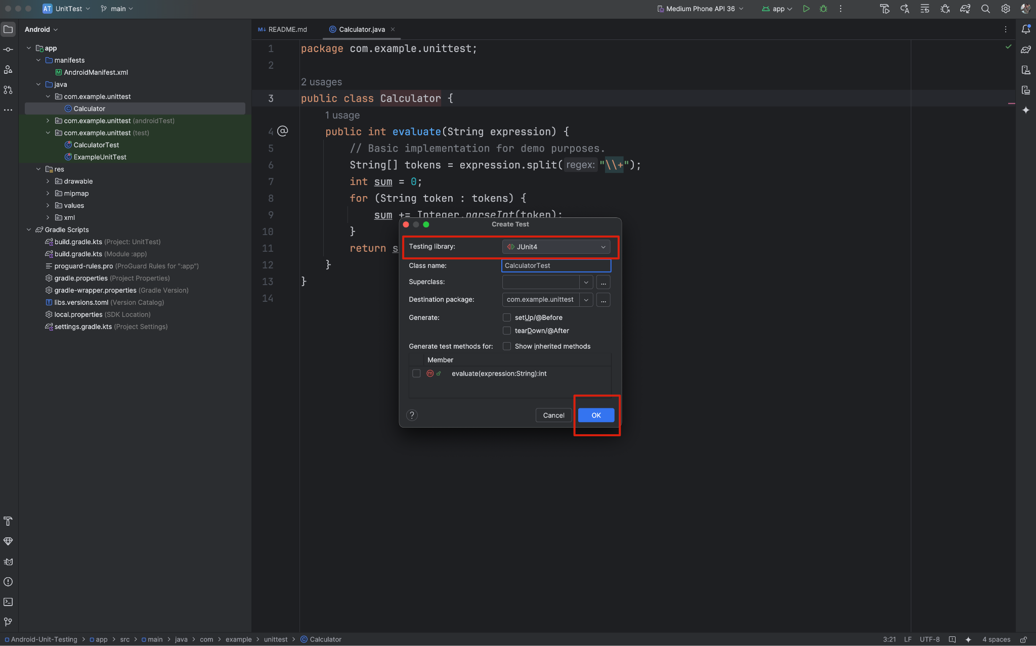
Part 2 ー Today: Unit Testing in Android
right click on the Class name and choose "Generate -> Test" and the boilerplate of the test will be generated in the correct place
Credits: https://github.com/junit-team/junit4/wiki/Use-with-Gradle

Slide 17
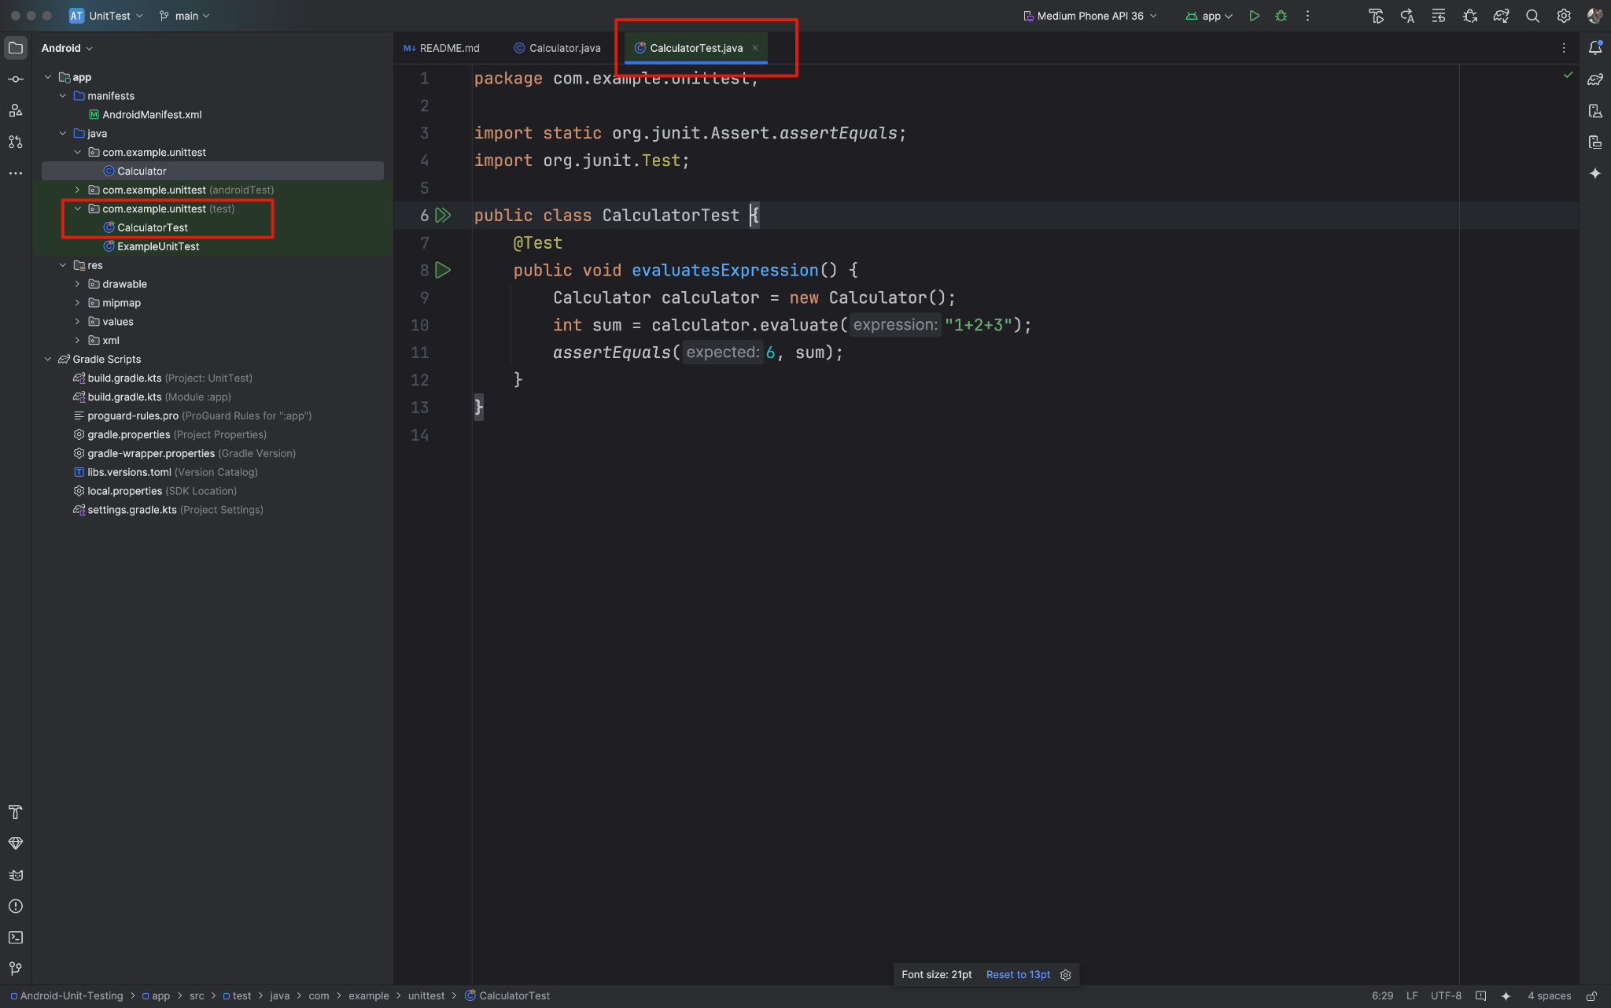
Part 2 ー Today: Unit Testing in Android
The testing codes will be automatically generated!
Credits: https://github.com/junit-team/junit4/wiki/Use-with-Gradle

Slide 18
Part 2 ー Today: Unit Testing in Android
Open your terminal and go to the project folder
$ cd Desktop/UnitTest/
Then run the unit testing
$ ./gradlew test
Check the code if you need it: Android-Unit-Testing
Credits: https://github.com/junit-team/junit4/wiki/Use-with-Gradle

Slide 19
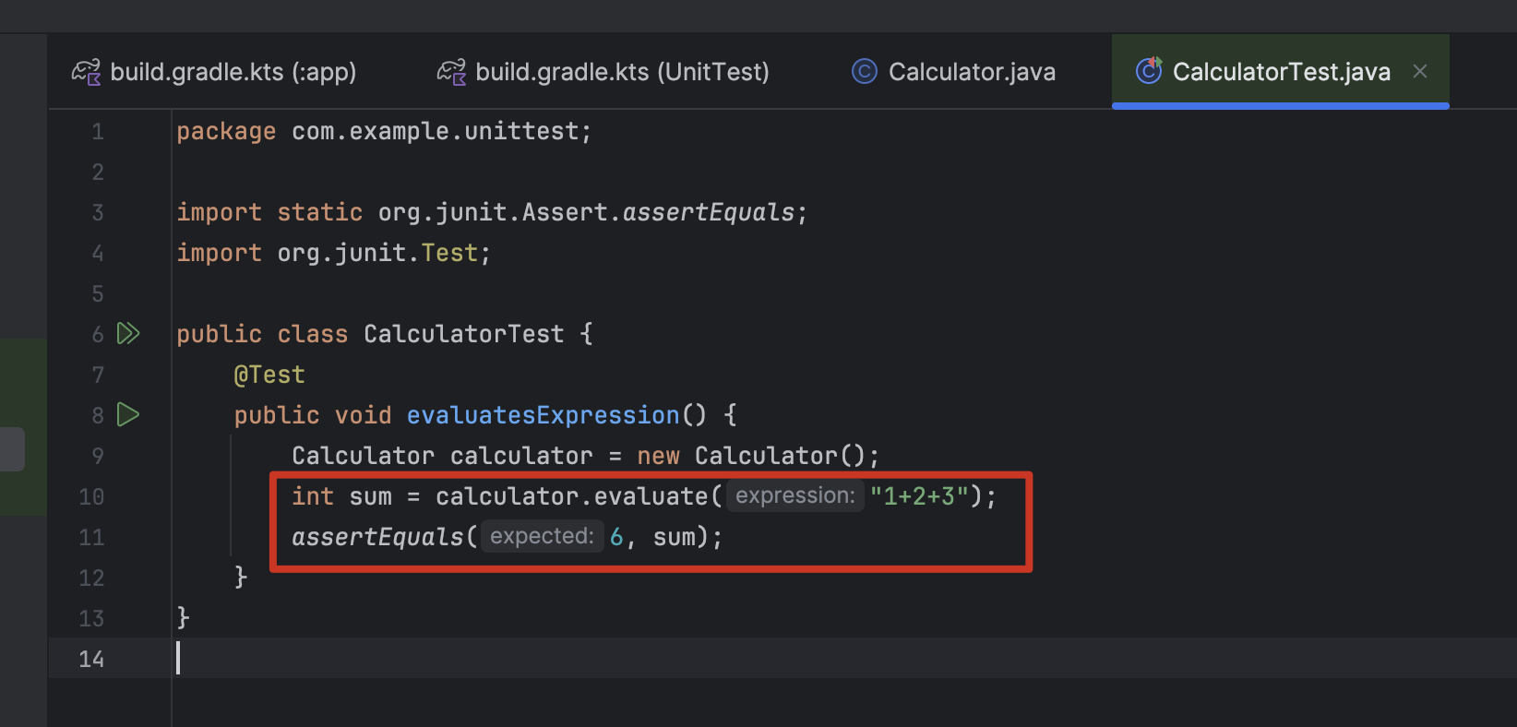
Part 2 ー Today: Unit Testing in Android
Credits: https://github.com/junit-team/junit4/wiki/Use-with-Gradle

Slide 20
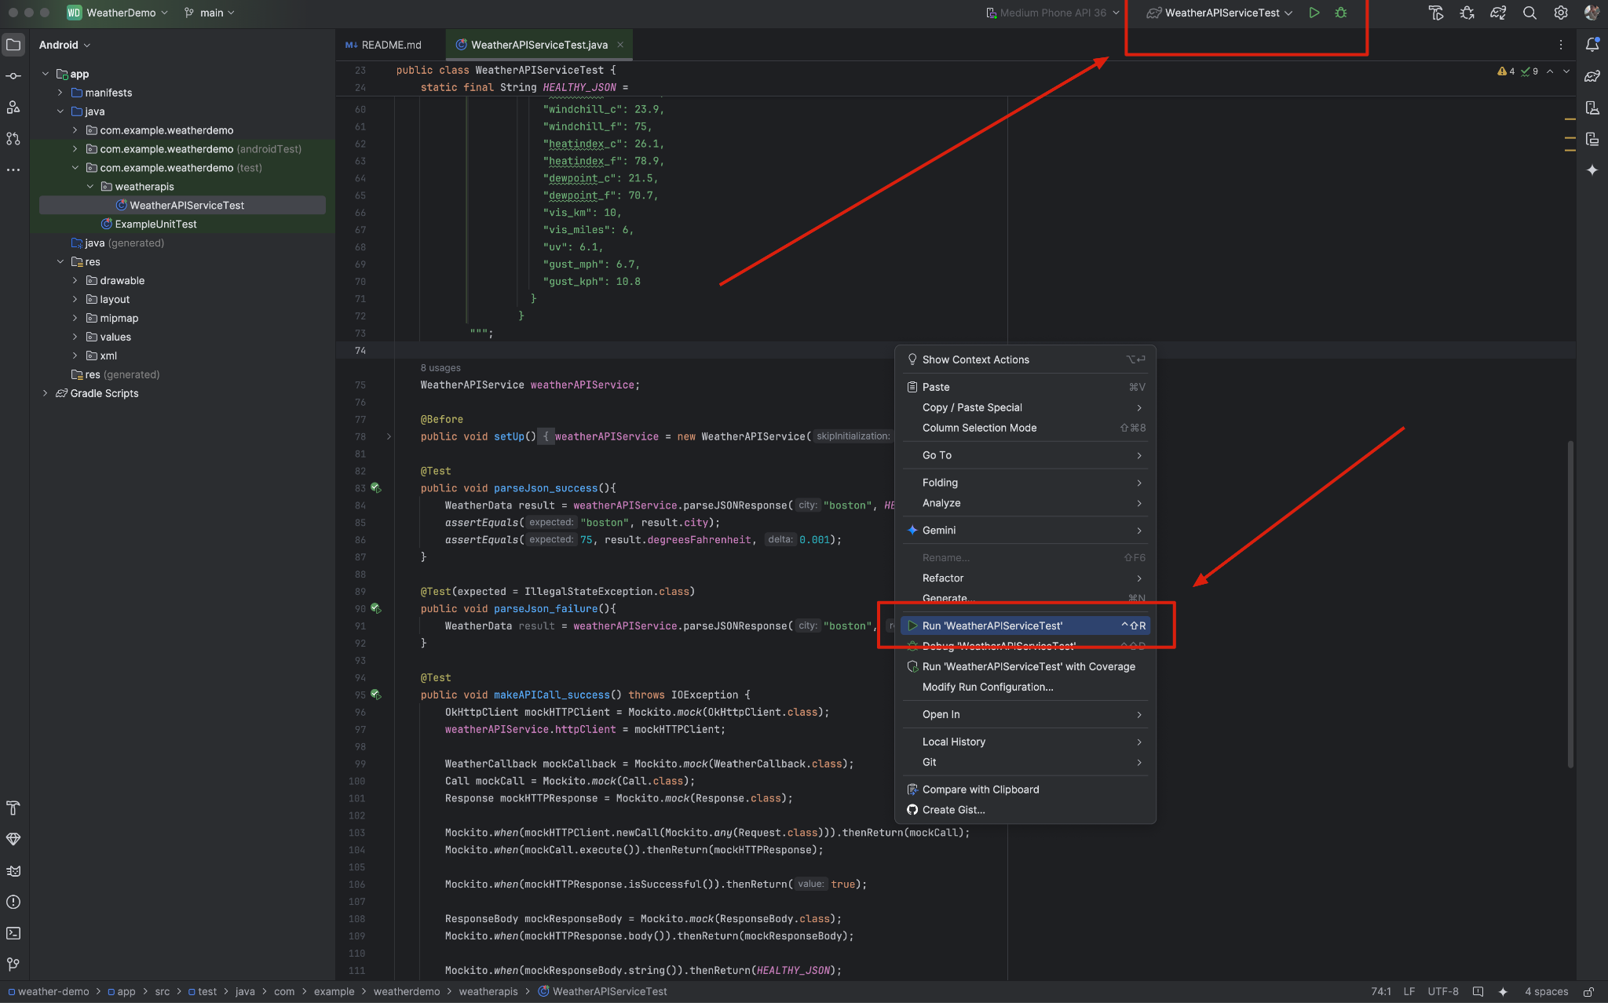
Part 2 ー Today: Unit Testing in Android
Credits: https://github.com/junit-team/junit4/wiki/Use-with-Gradle

Slide 21
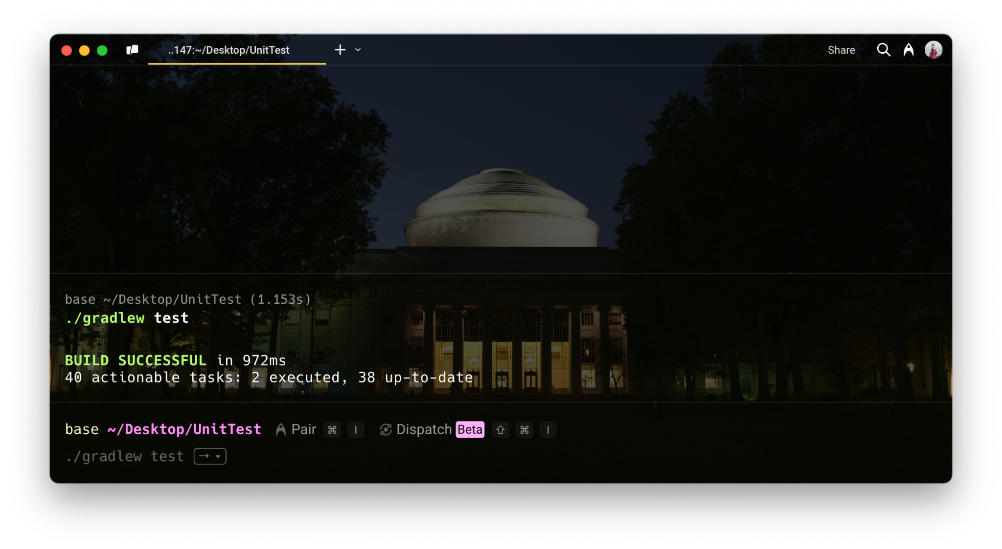
Part 2 ー Today: Unit Testing in Android
Credits: https://github.com/junit-team/junit4/wiki/Use-with-Gradle

Slide 22
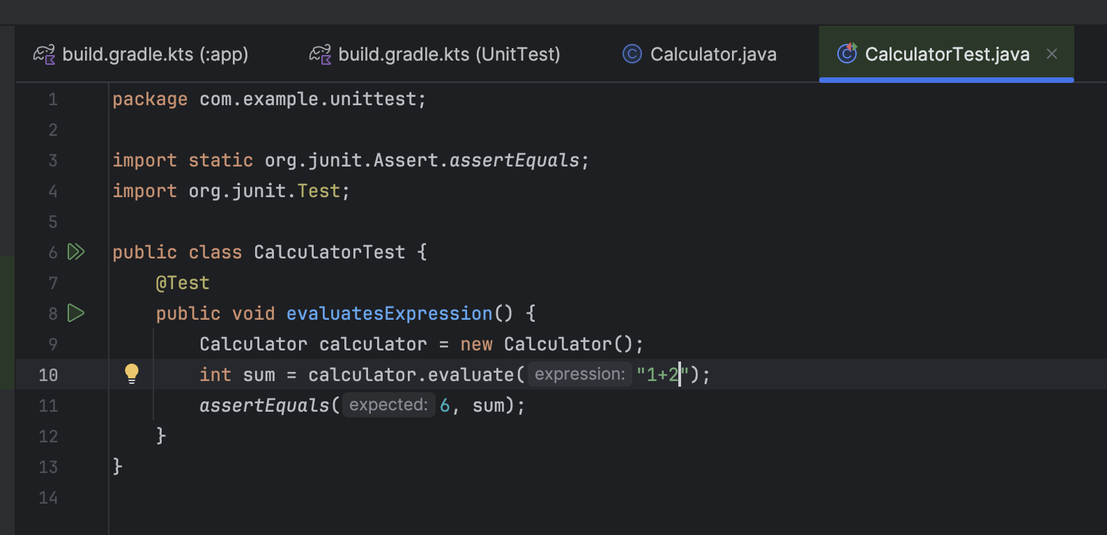
Part 2 ー Today: Unit Testing in Android
Credits: https://github.com/junit-team/junit4/wiki/Use-with-Gradle

Slide 23
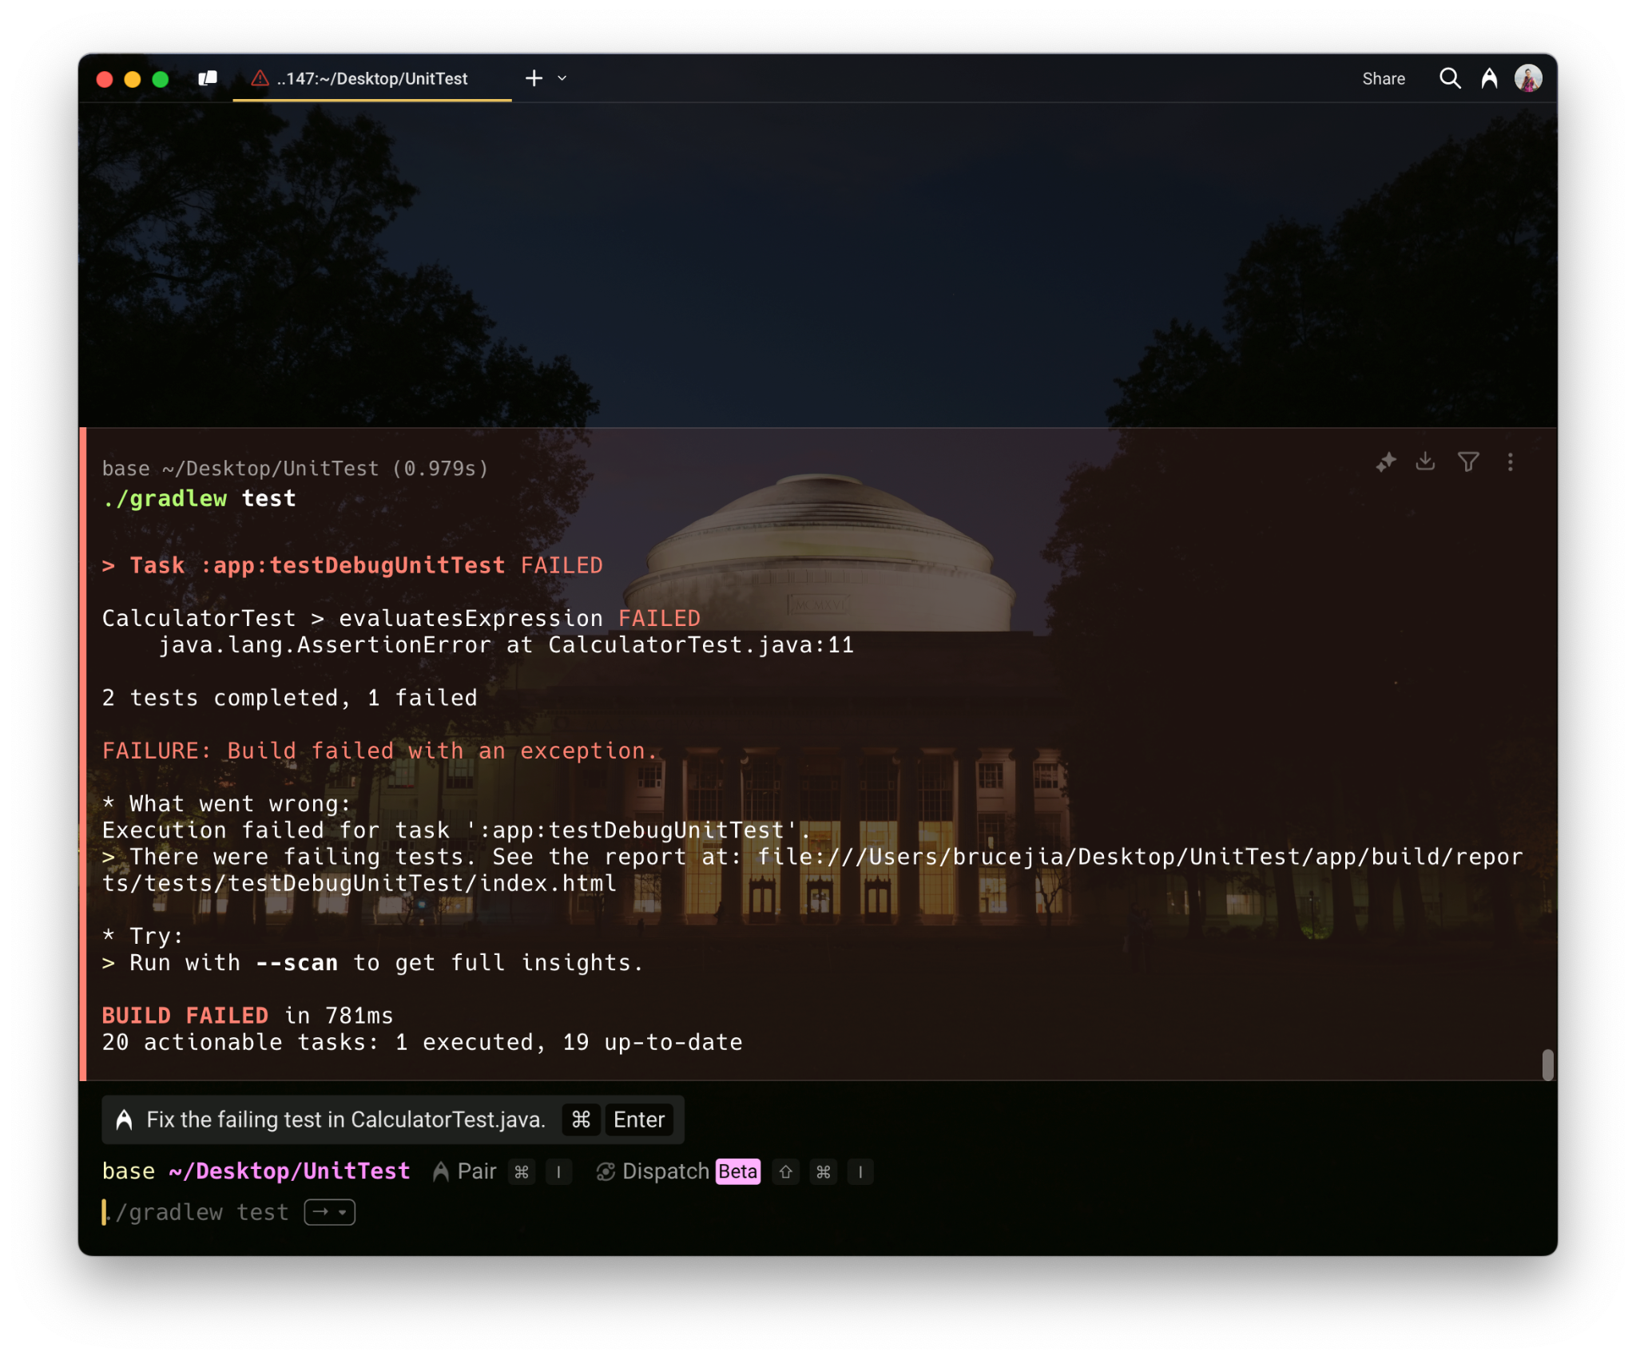
Part 2 ー Today: Unit Testing in Android
Credits: https://github.com/junit-team/junit4/wiki/Use-with-Gradle

Slide 24
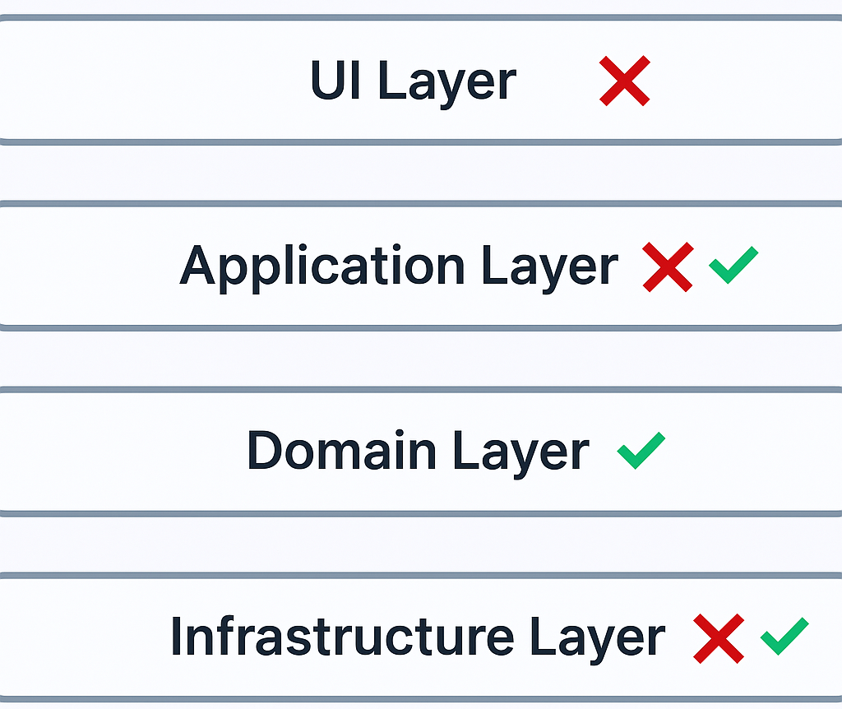
Part 3 ー Unit Testing Constraints
Unit Test is not aware of Nullability
Don't use Singleton
Static Methods has hidden dependencies, so can not be substituted
Credits: https://www.slideshare.net/slideshow/unit-testing-in-android-156437598/156437598#15

Slide 25
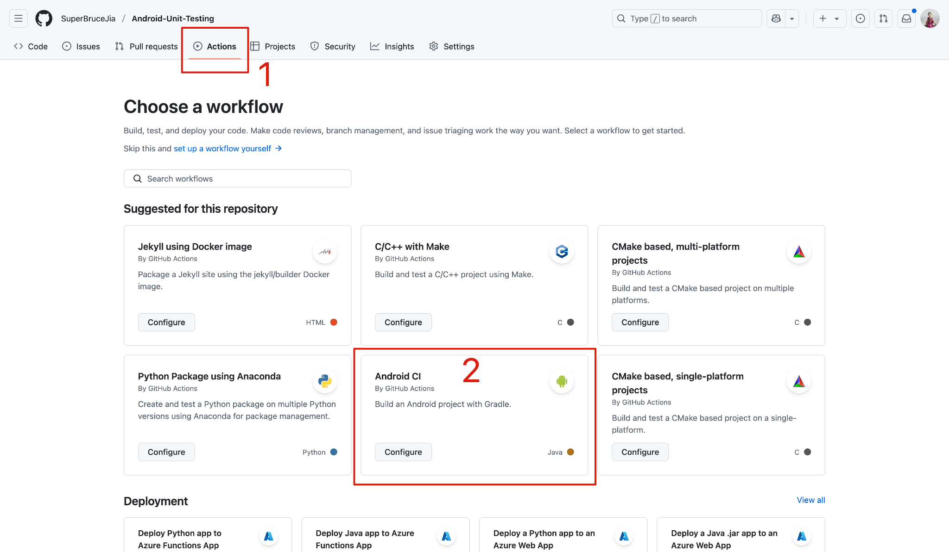
Part 4 ー Test Suits with GitHub Actions (Android CI)

Slide 26
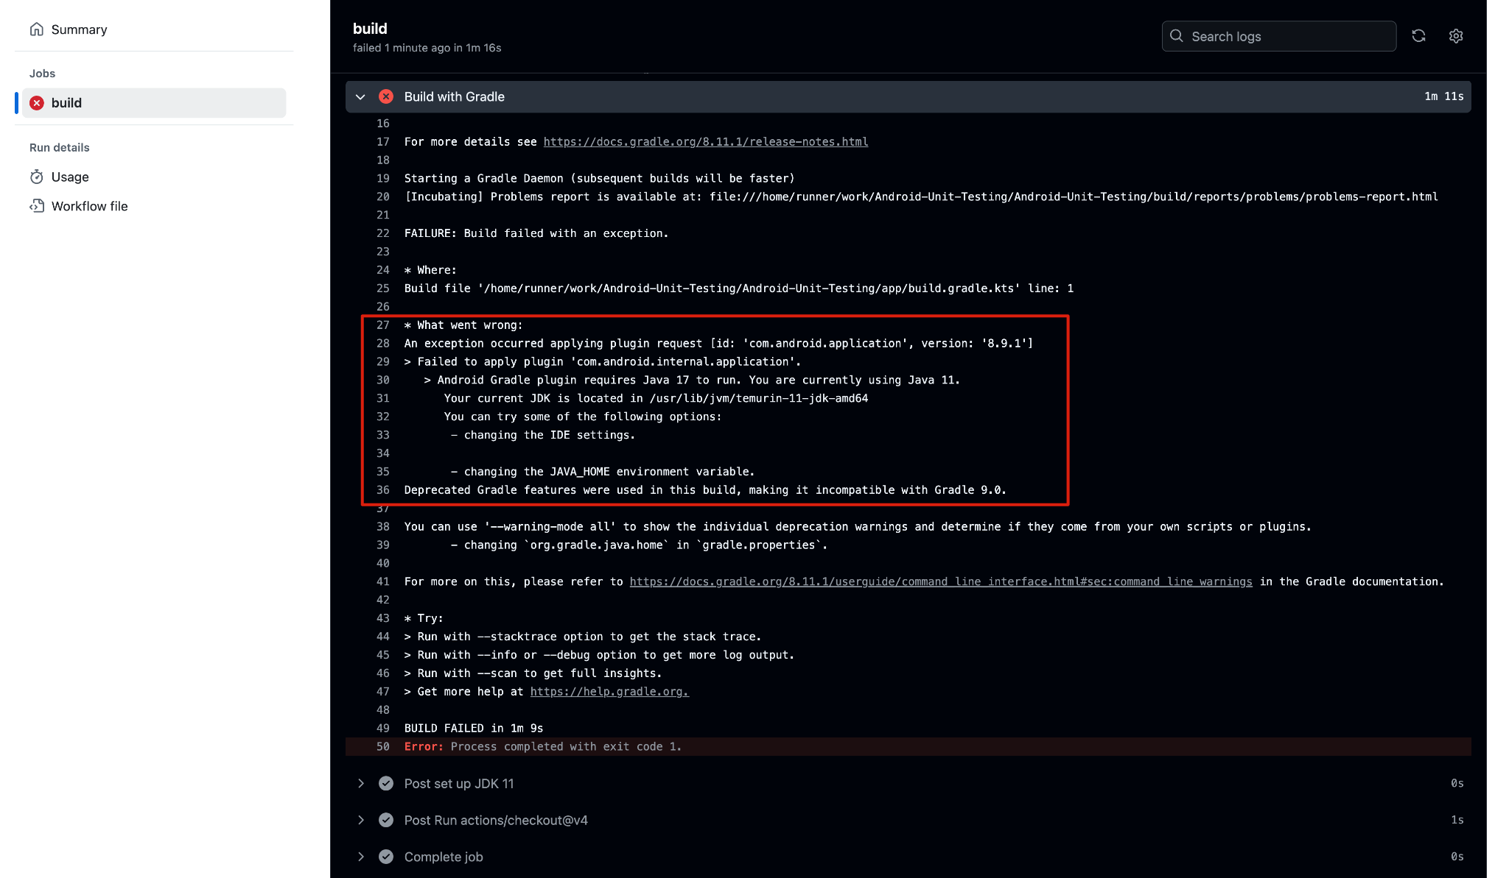
Part 4 ー Test Suits with GitHub Actions (Android CI)
Check the configurations and select which one do you need or don't need.
We need Java 17 to run the Gradle plugin

Slide 27
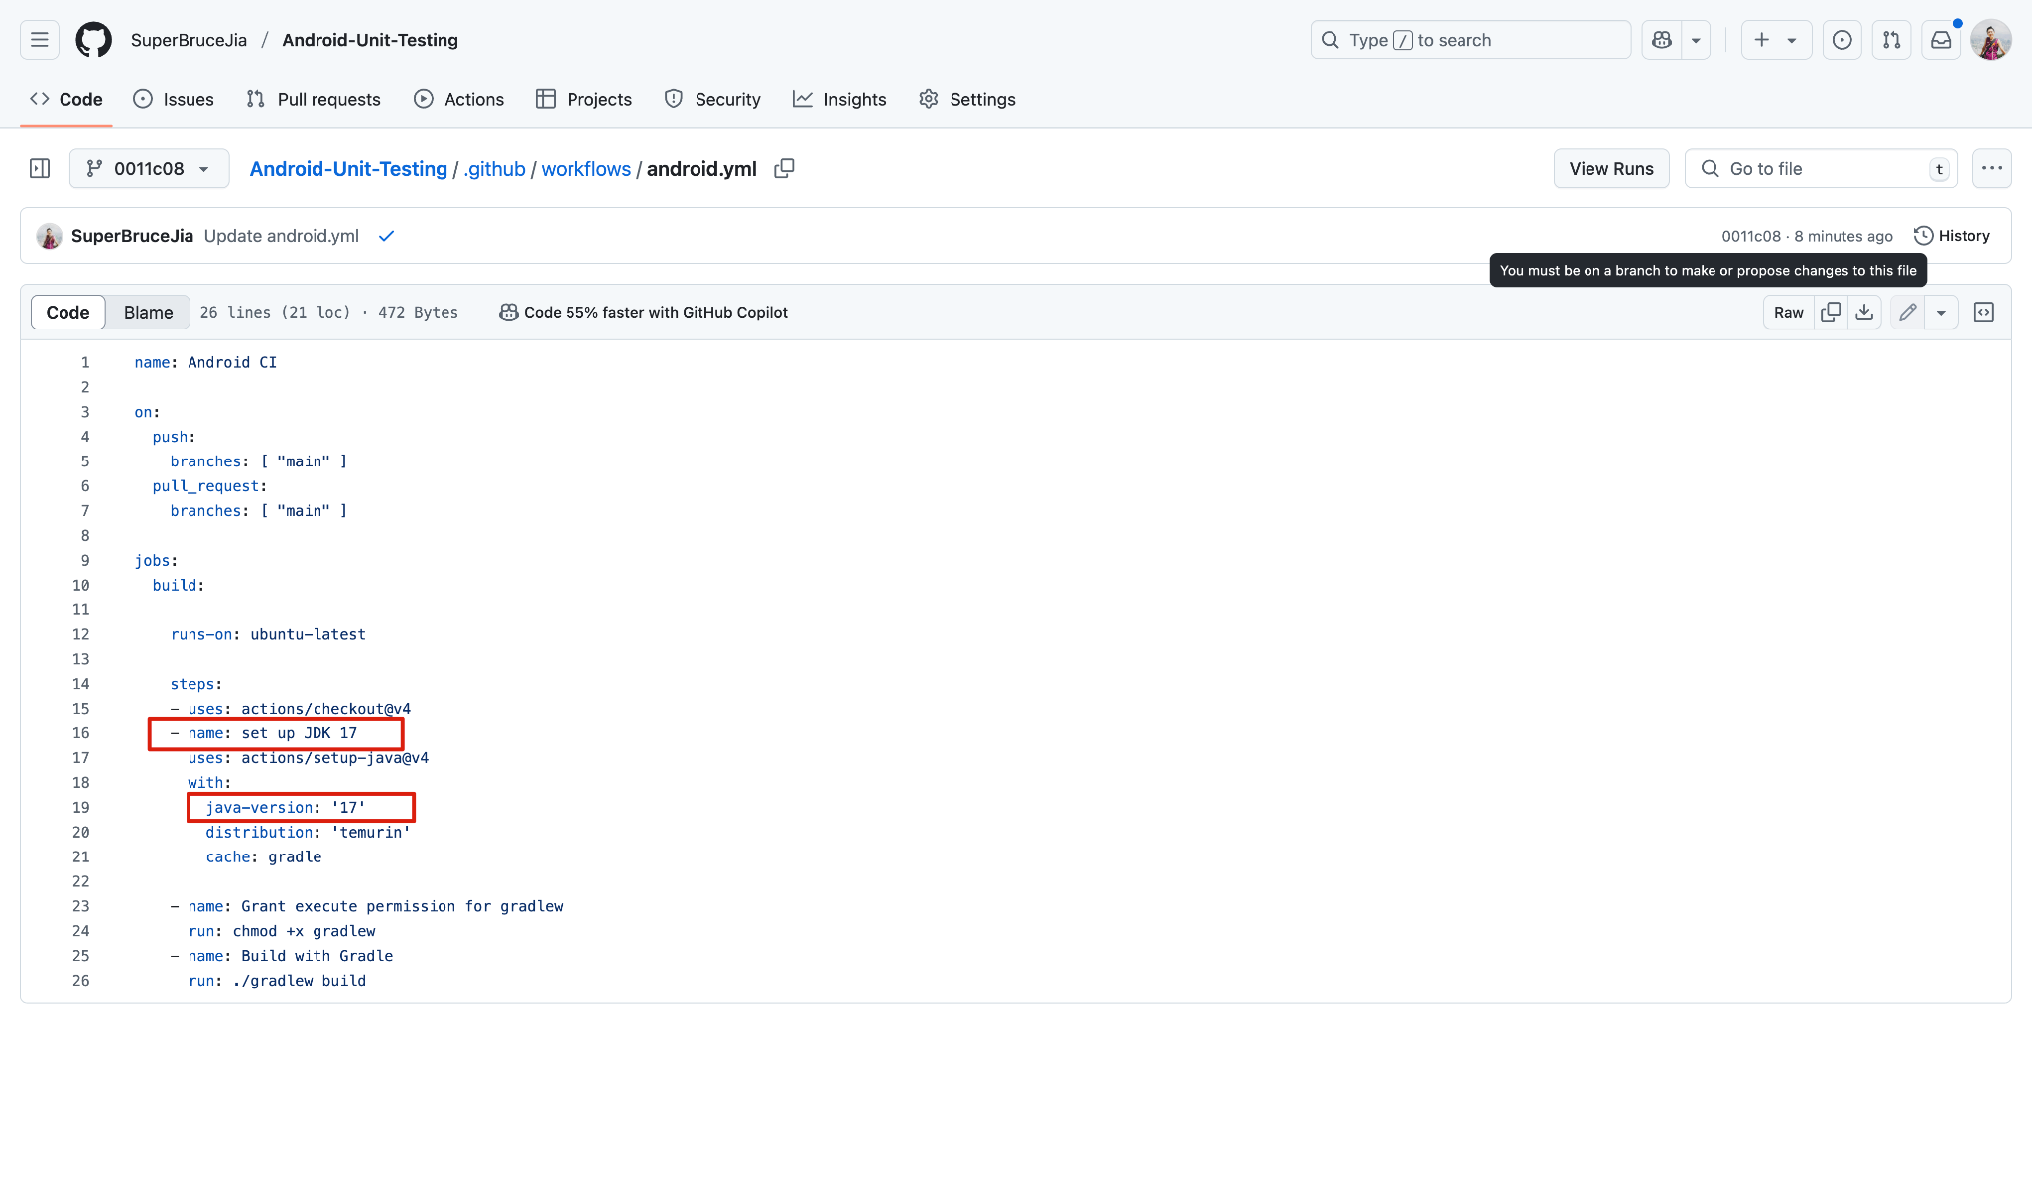
Part 4 ー Test Suits with GitHub Actions (Android CI)
We need to change Java version to 17 here

Slide 28

GitHub
“Take care of everything for you”

Slide 29
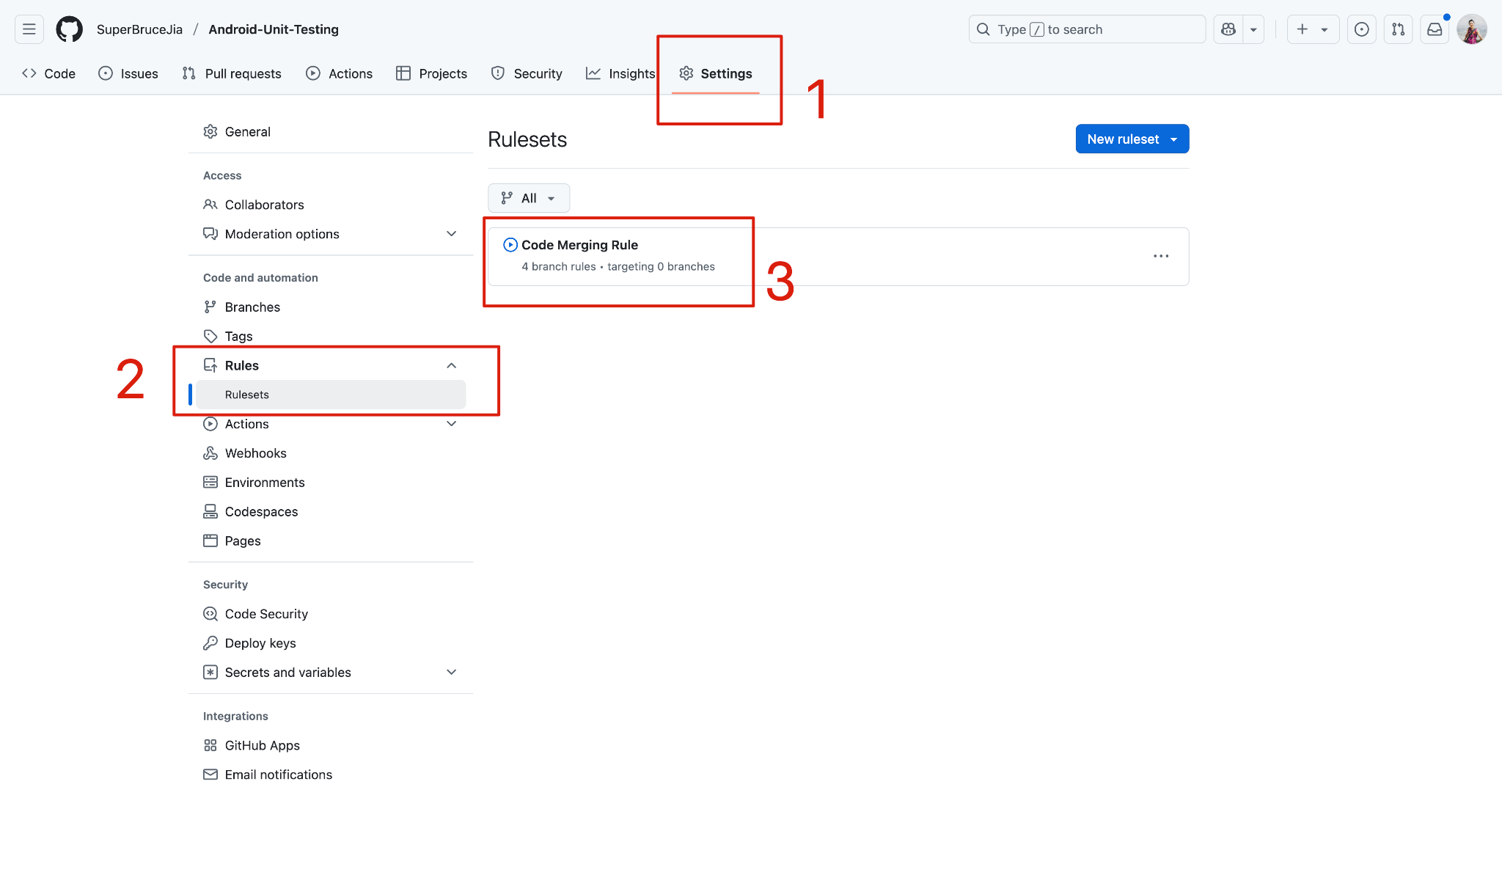
Part 5 ー Code Merging after Passing Unit Testing
Since there has been a rule set created already that enforces that nothing can be pushed directly to the main branch - everything has to go through a pull request and approval process before being merged.
You can update the existing rule!

Slide 30
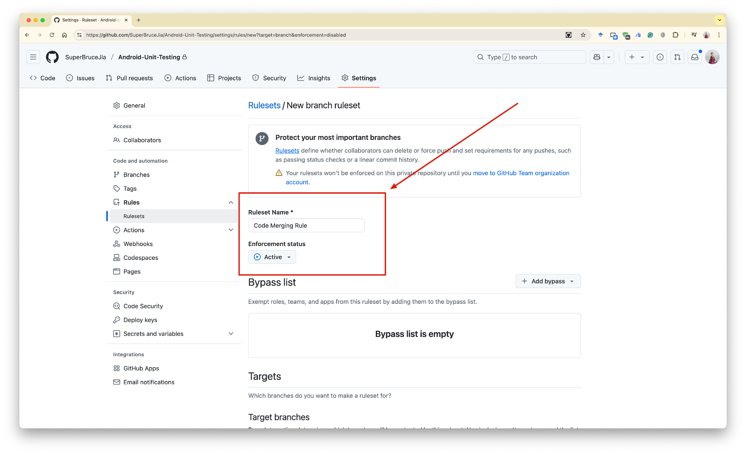
Part 5 ー Code Merging after Passing Unit Testing

Slide 31
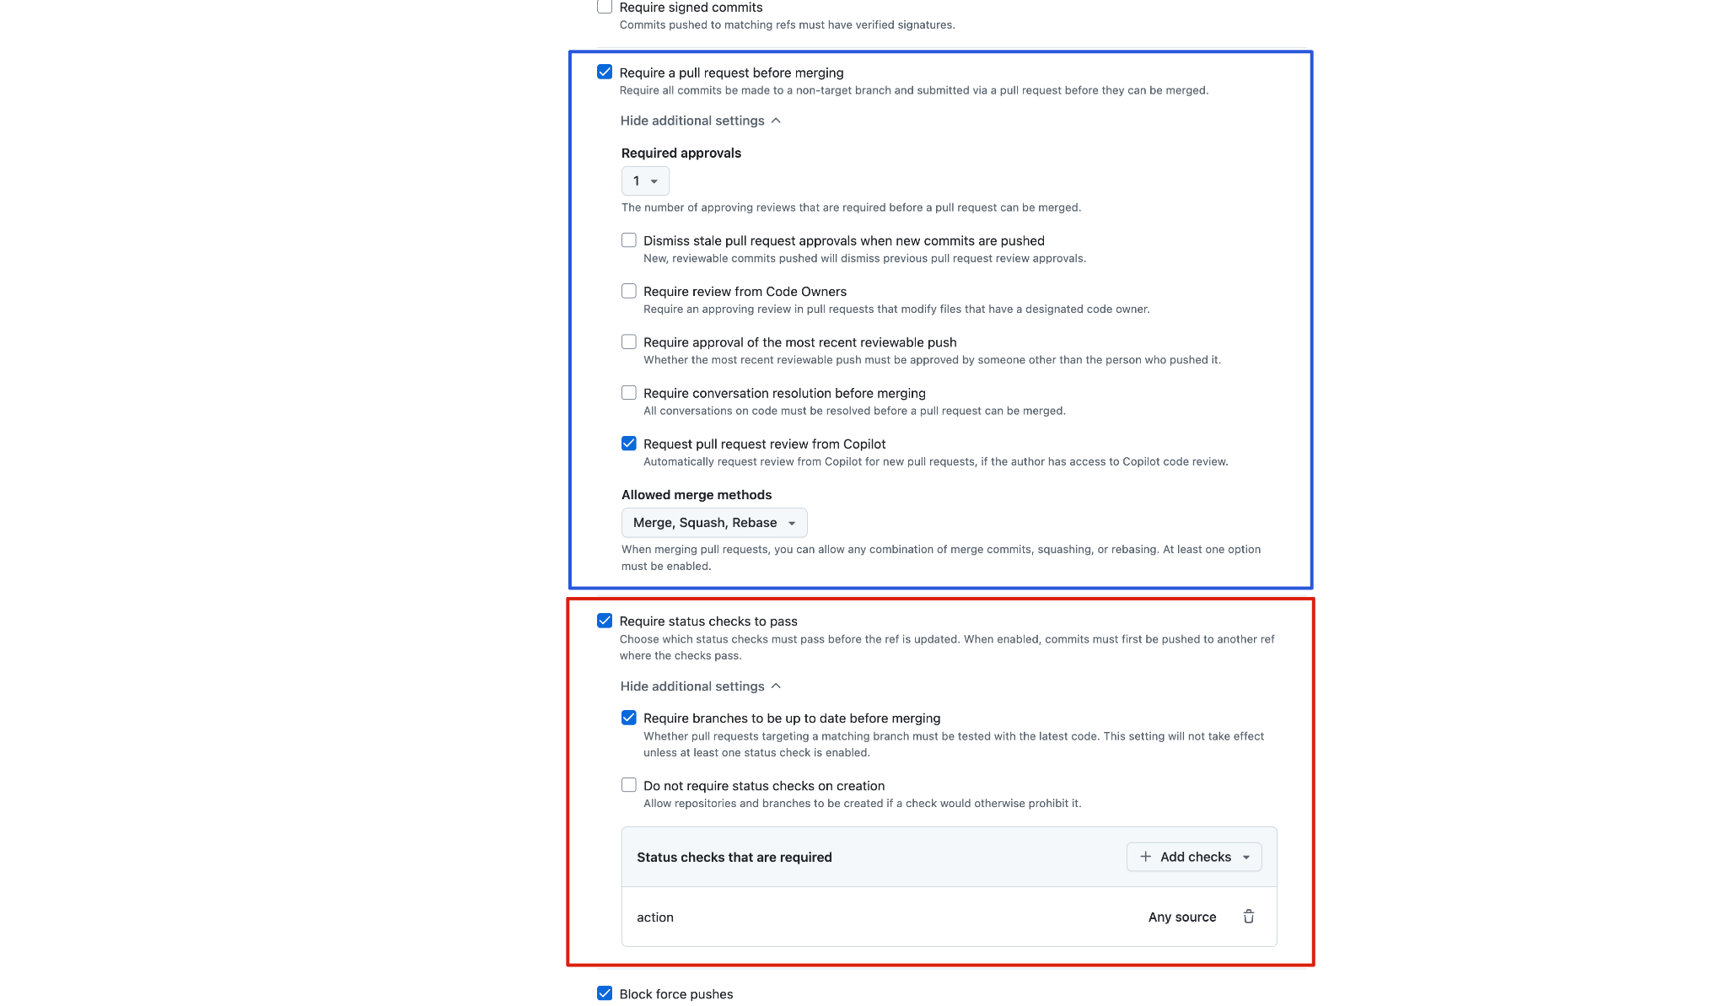
Part 5 ー Code Merging after Passing Unit Testing
This has been set for all of you
pull requests cannot be merged until all the testing has passed

Slide 32
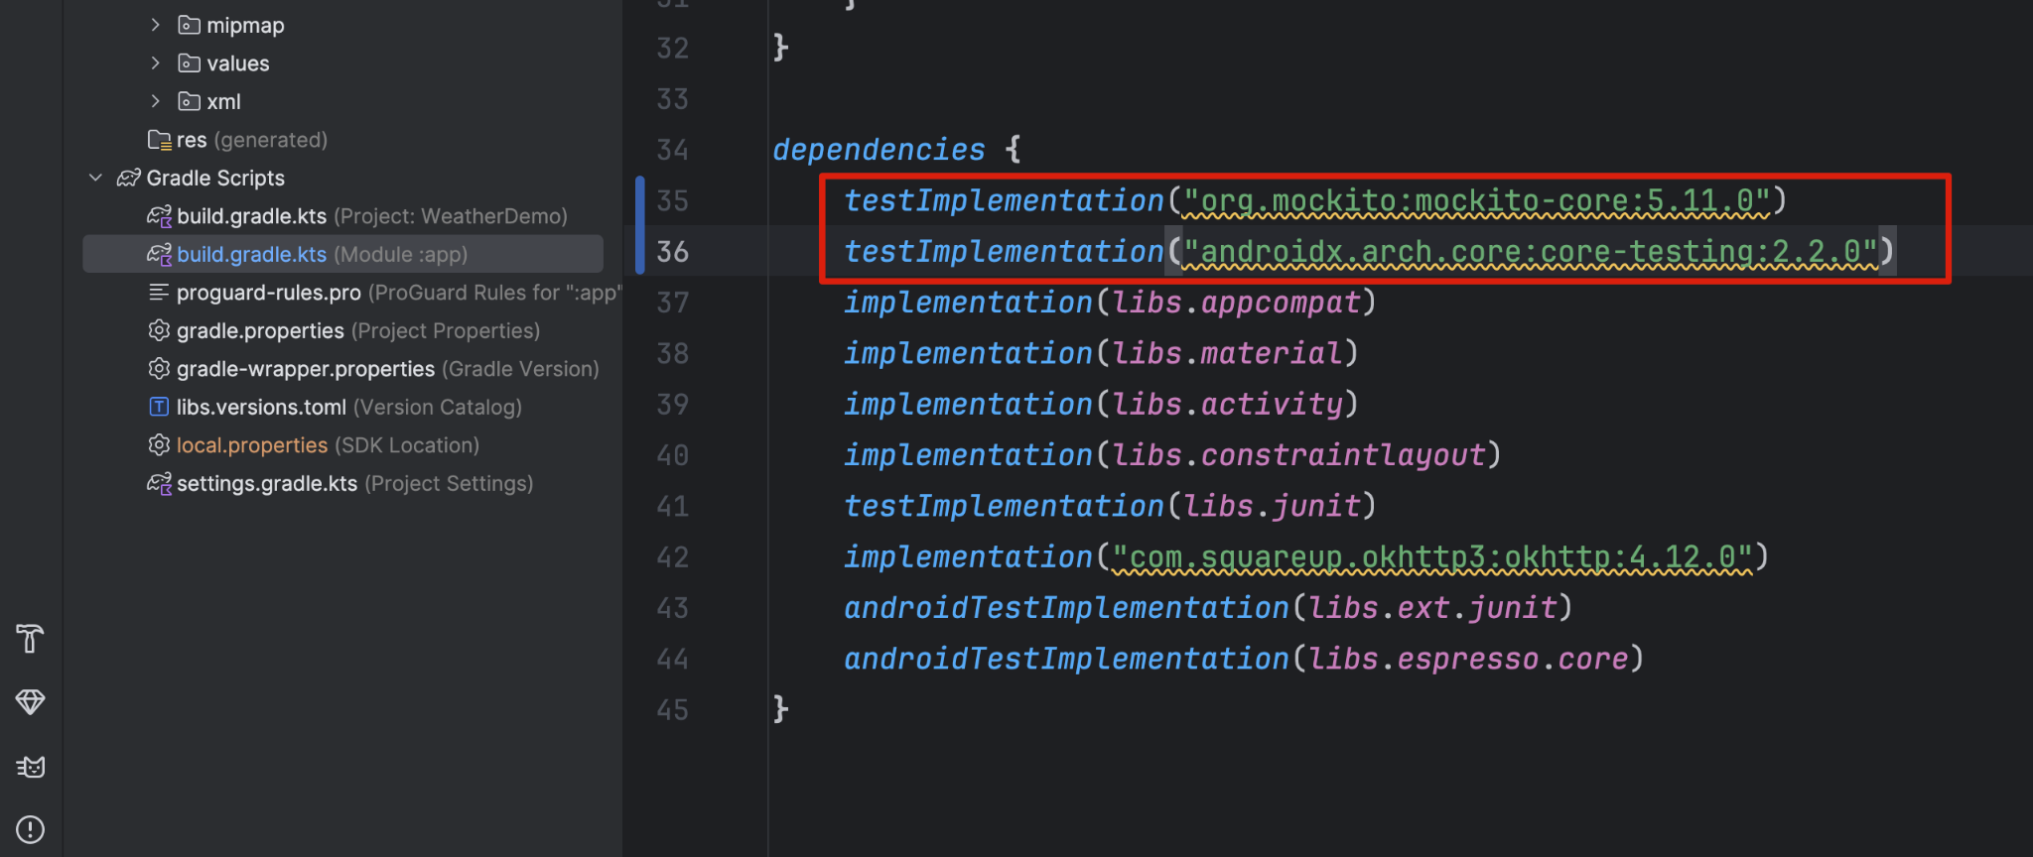
Part 6 ー Weather Demo Unit Testing
We need these two dependencies in the build.gradle file:
testImplementation("org.mockito:mockito-core:5.11.0")
testImplementation("androidx.arch.core:core-testing:2.2.0")
Credits: https://github.com/BU-EC327-Spring2025/weather-demo/blob/main/app/build.gradle.kts#L43-L56

Slide 33
Part 6 ー Weather Demo Unit Testing
import necessary packages and dependencies:
For Mockito framework:
import org.junit.Before;
import org.junit.Test;
import org.mockito.Mockito;
For @RunWith(AndroidJUnit4.class) framework:
import androidx.test.ext.junit.runners.AndroidJUnit4;
import org.junit.Test;
import org.junit.runner.RunWith;
Credits:
[1]https://github.com/BU-EC327-Spring2025/weather-demo/blob/main/app/src/test/java/com/example/weatherdemo/weatherapis/WeatherAPIServiceTest.java
[2]https://github.com/BU-EC327-Spring2025/weather-demo/blob/main/app/src/androidTest/java/com/example/weatherdemo/DependencyManagerTest.java

Slide 34
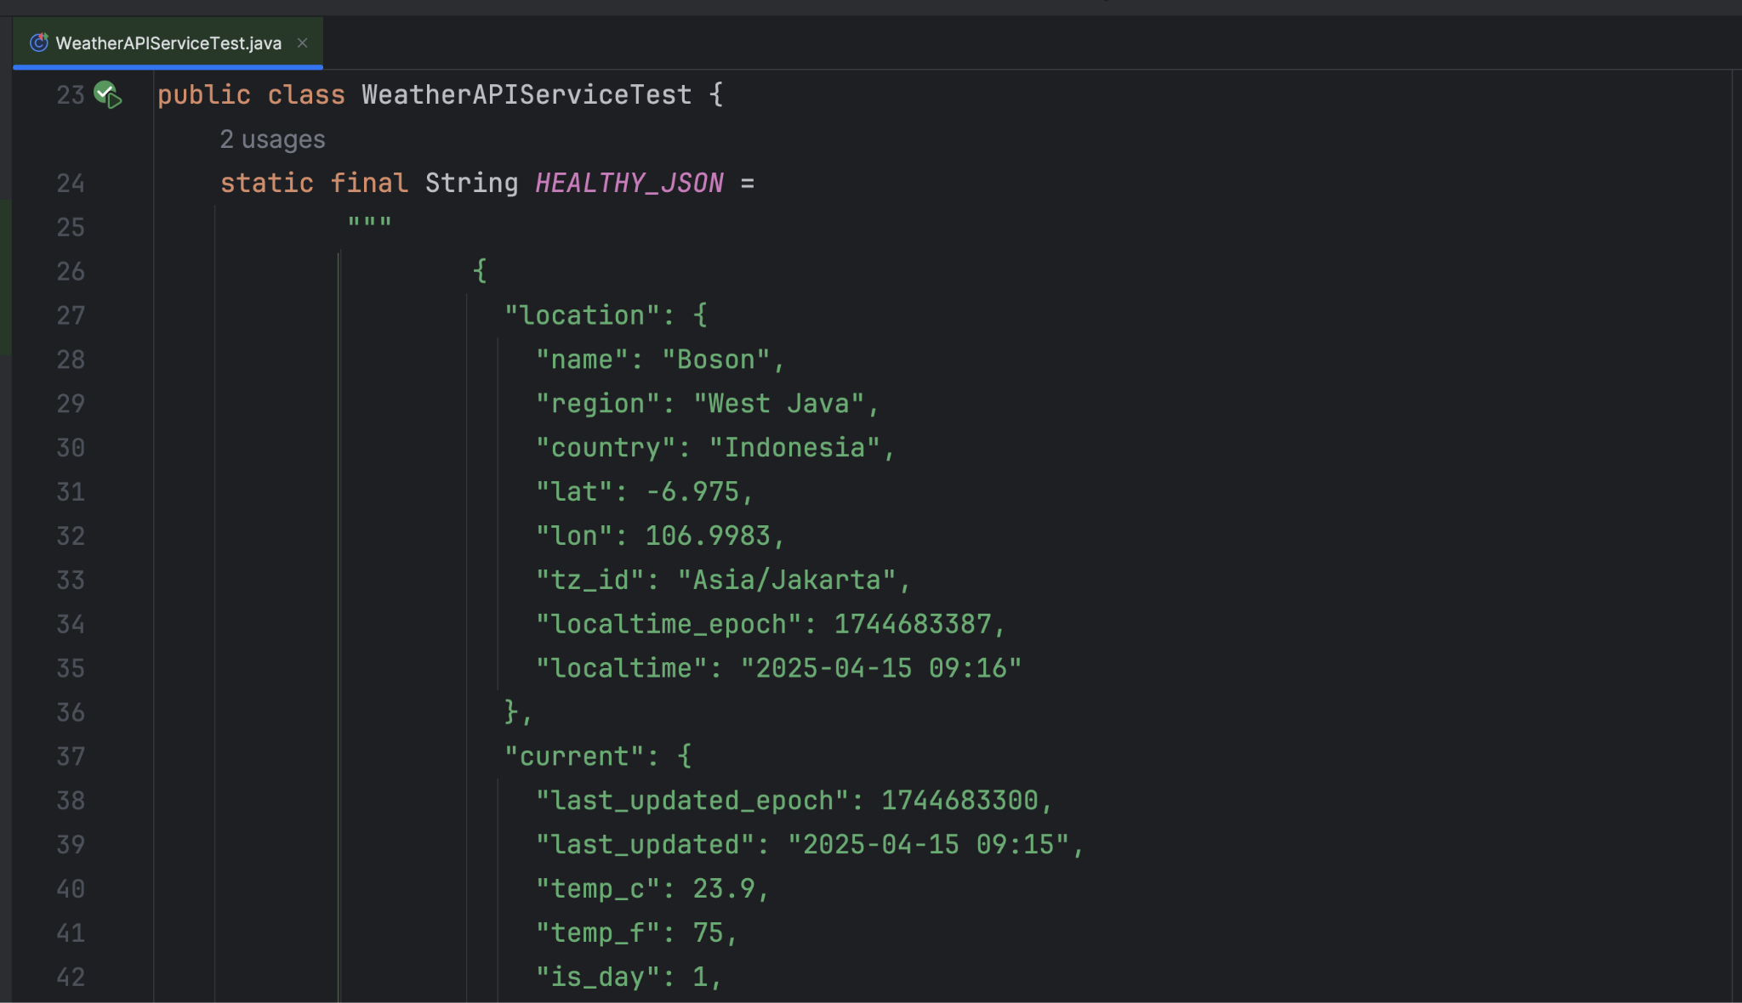
Part 6 ー Weather Demo Unit Testing
Credits: https://github.com/BU-EC327-Spring2025/weather-demo/blob/main/app/src/test/java/com/example/weatherdemo/weatherapis/WeatherAPIServiceTest.java

Slide 35
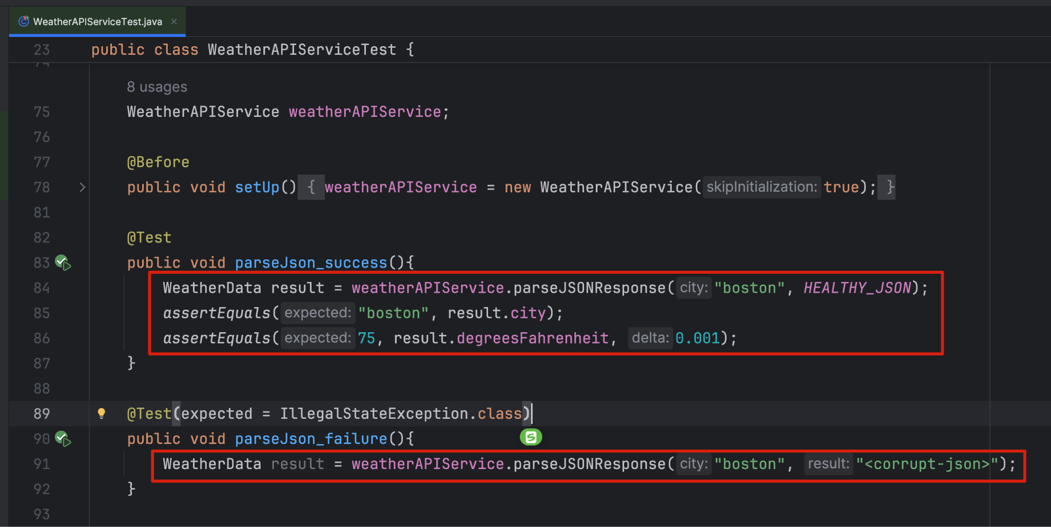
Part 6 ー Weather Demo Unit Testing
just testing json parsing

Slide 36
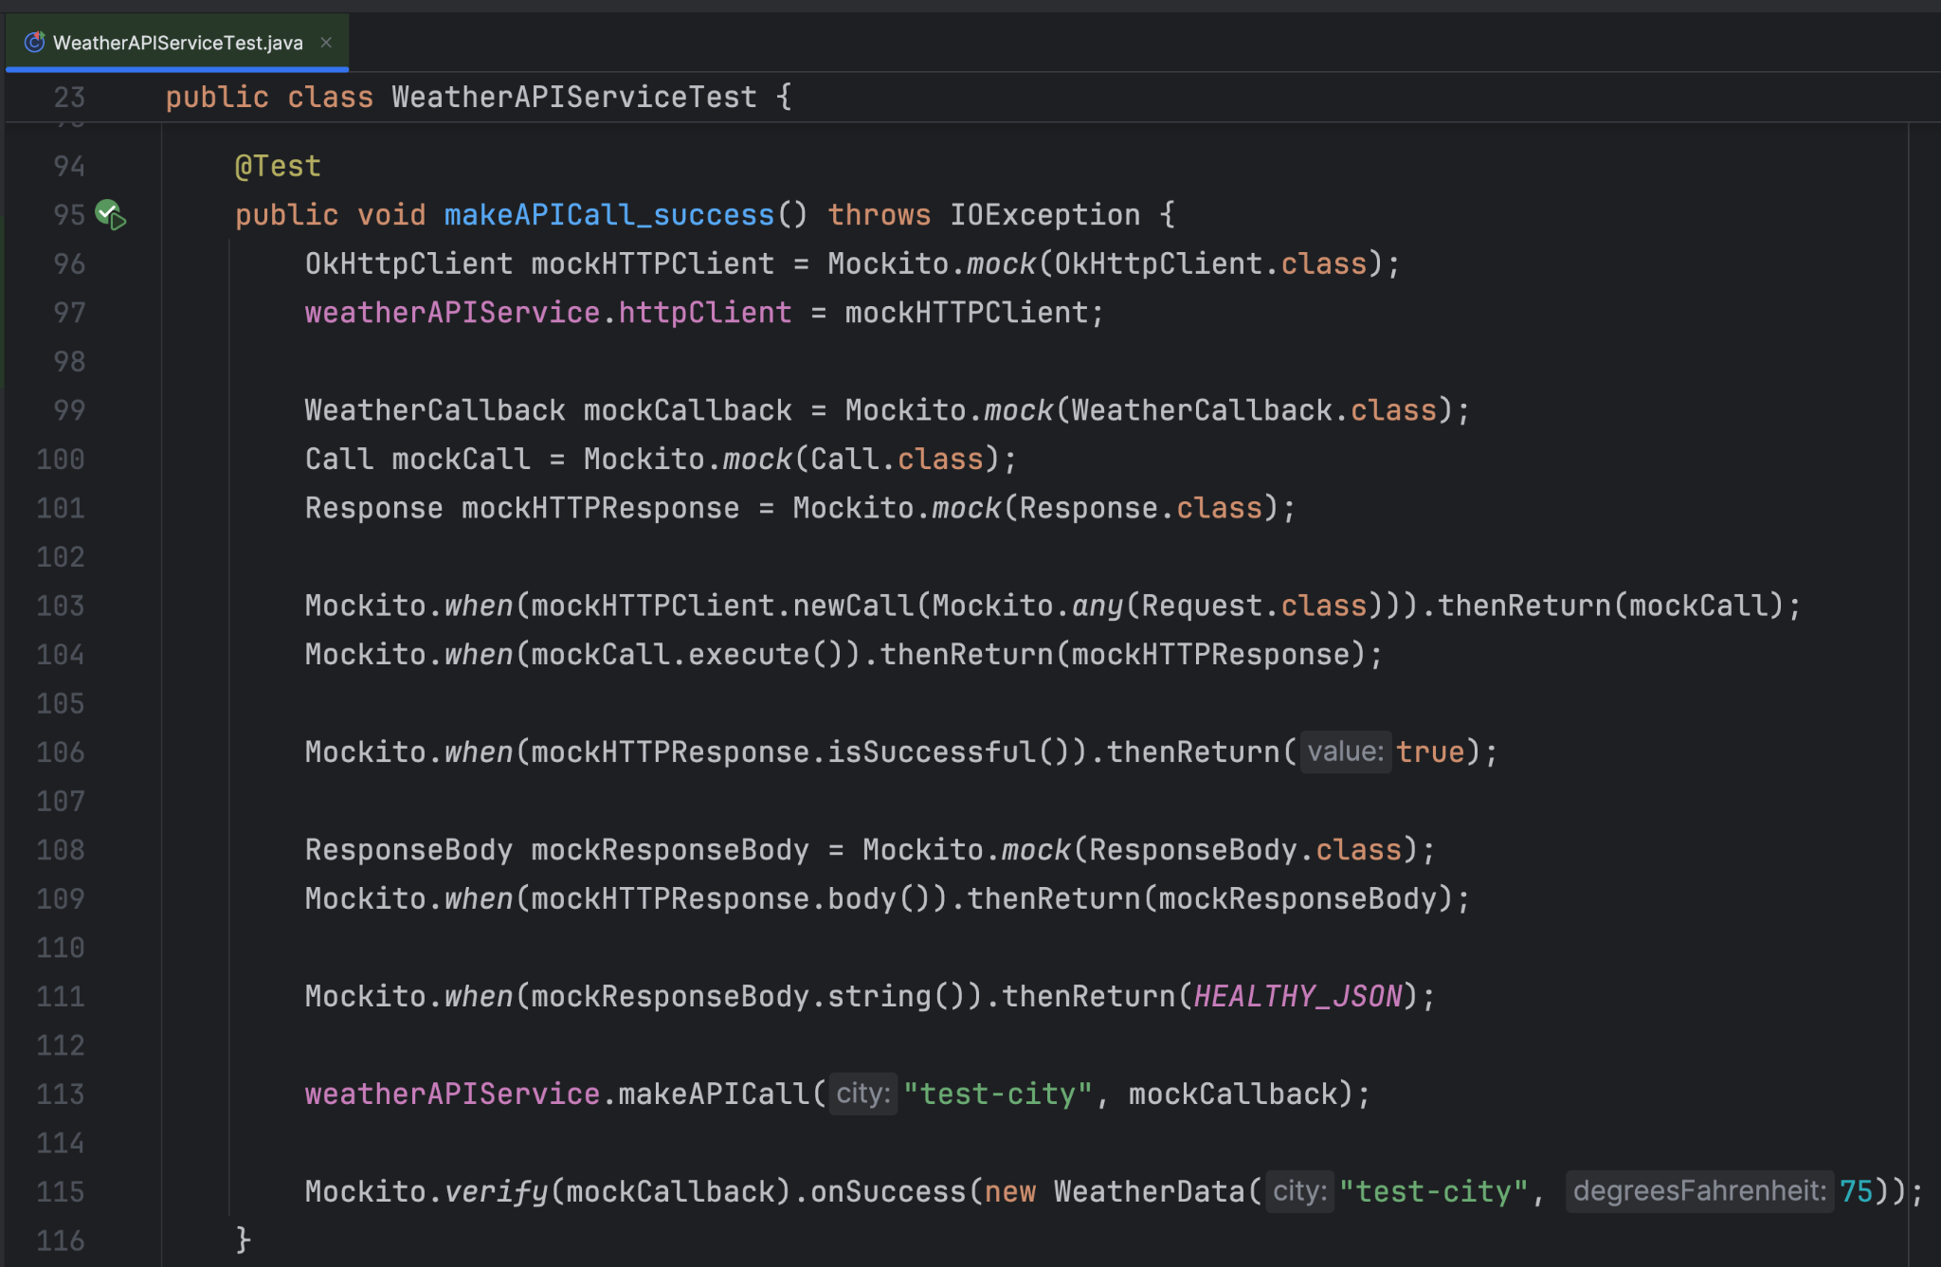
Part 6 ー Weather Demo Unit Testing
mock out httpClient and mainThreadHandler and cover the code in WeatherAPIService around the logic of making that API call and handling its result
standard Java JUnit + Mockito unit test. There is nothing Android specific there

Slide 37
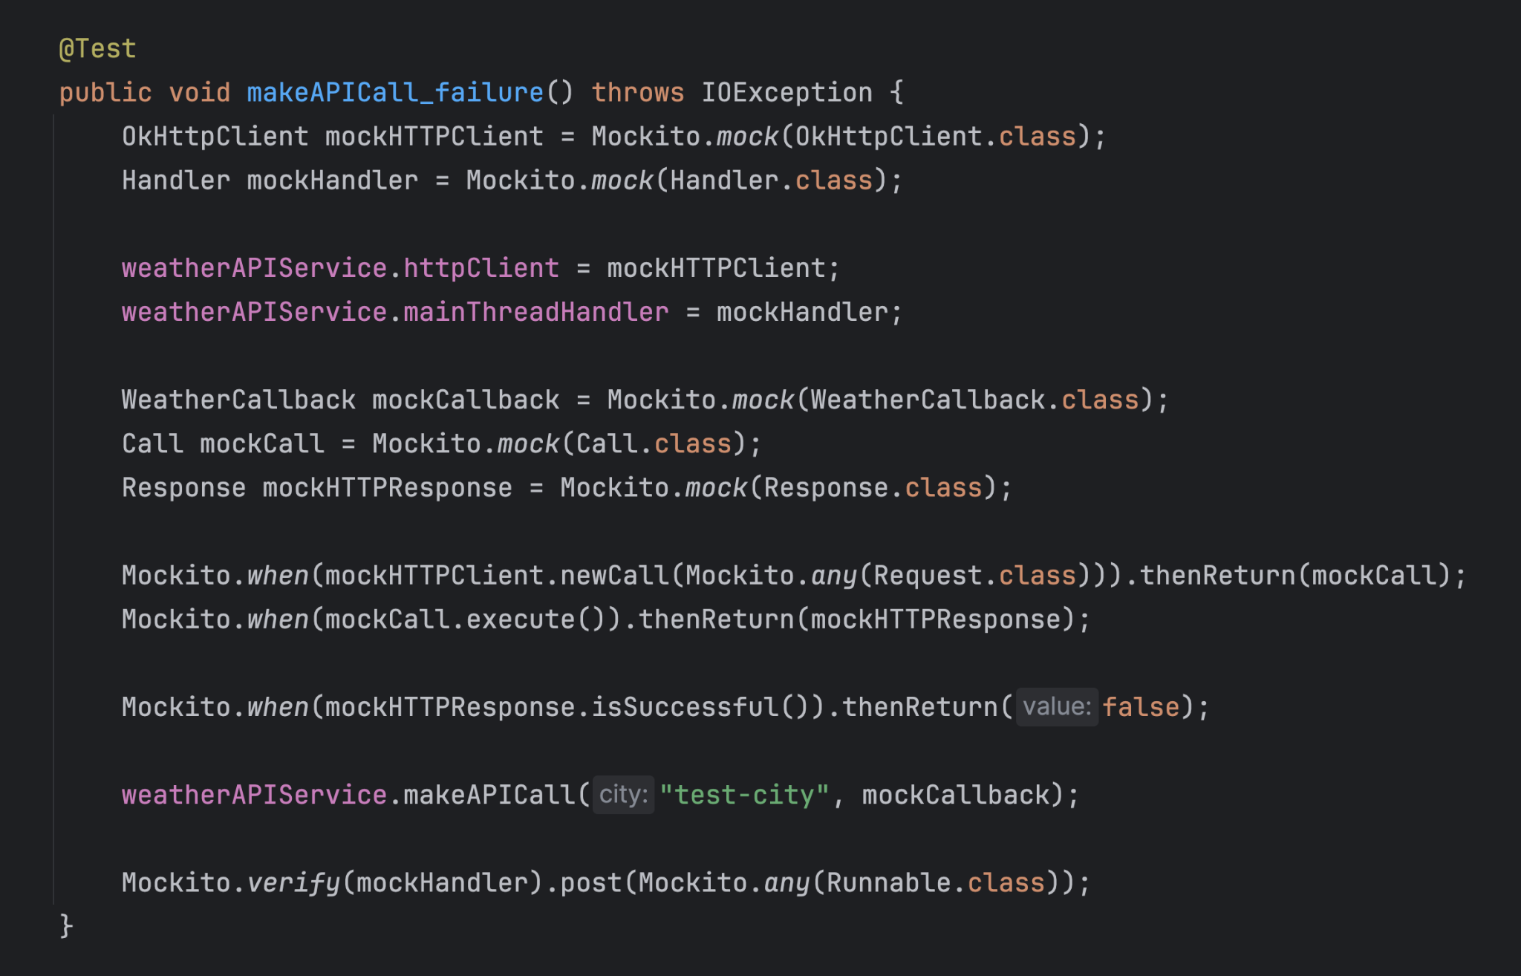
Part 6 ー Weather Demo Unit Testing
mock out httpClient and mainThreadHandler and cover the code in WeatherAPIService around the logic of making that API call and handling its result
standard Java JUnit + Mockito unit test. There is nothing Android specific there

Slide 38
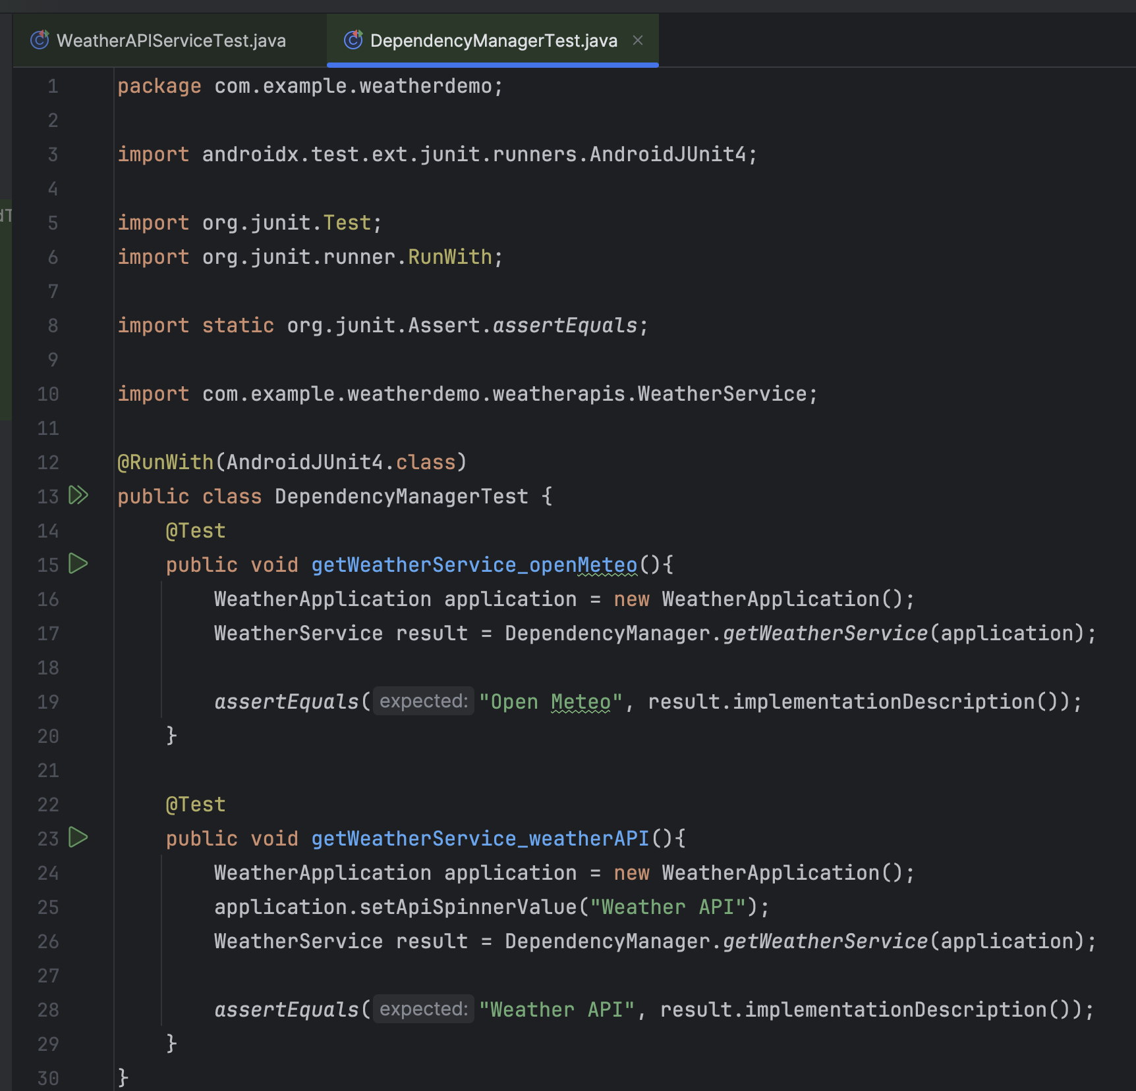
Part 6 ー Weather Demo Unit Testing
Credits: https://github.com/BU-EC327-Spring2025/weather-demo/blob/main/app/src/androidTest/java/com/example/weatherdemo/DependencyManagerTest.java
for anything that touches an Android UI component, or an Android activity, or an Android main thread, we need to use @RunWith(AndroidJUnit4.class)
these tests will be sigificantly slower because they will need to start the emulator and will get executed on the emnulator instead of just in the JVM

Slide 39
Part 6 ー Weather Demo Unit Testing
Instrumented Test Class
Run a specific Instrumented Test Class $ ./gradlew connectedAndroidTest -Pandroid.testInstrumentationRunnerArguments.class=com.example.weatherdemo.DependencyManagerTest
Run a specific Instrumented Test Class $ ./gradlew connectedAndroidTest -Pandroid.testInstrumentationRunnerArguments.class=com.example.weatherdemo.DependencyManagerTest#methodName
Run All Instrumented Tests $ ./gradlew connectedAndroidTest test
Clean all build artifacts and test results $ ./gradlew clean
Clean and then run all tests $ ./gradlew clean test connectedAndroidTest

Slide 40
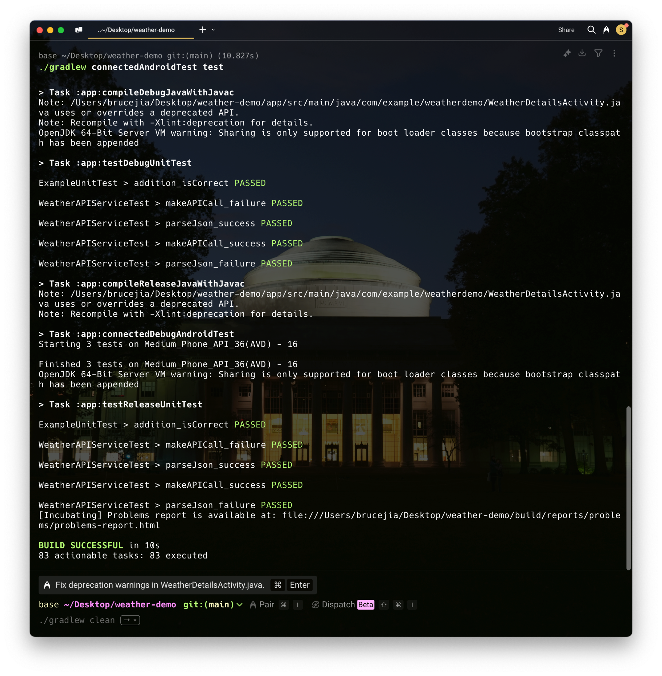
Instrumented Test Class

Slide 41
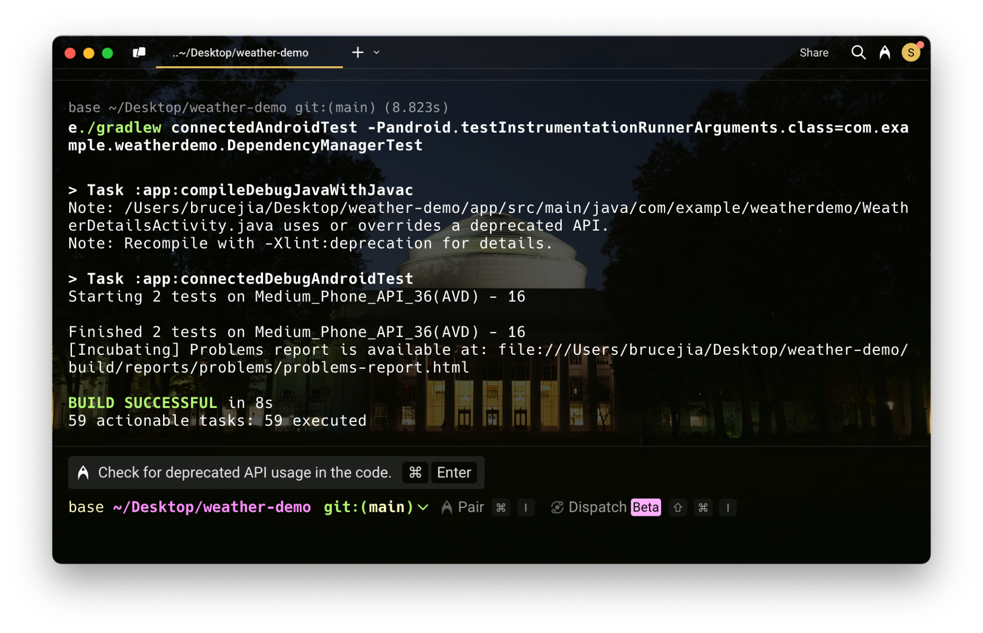
Instrumented Test Class

Slide 42
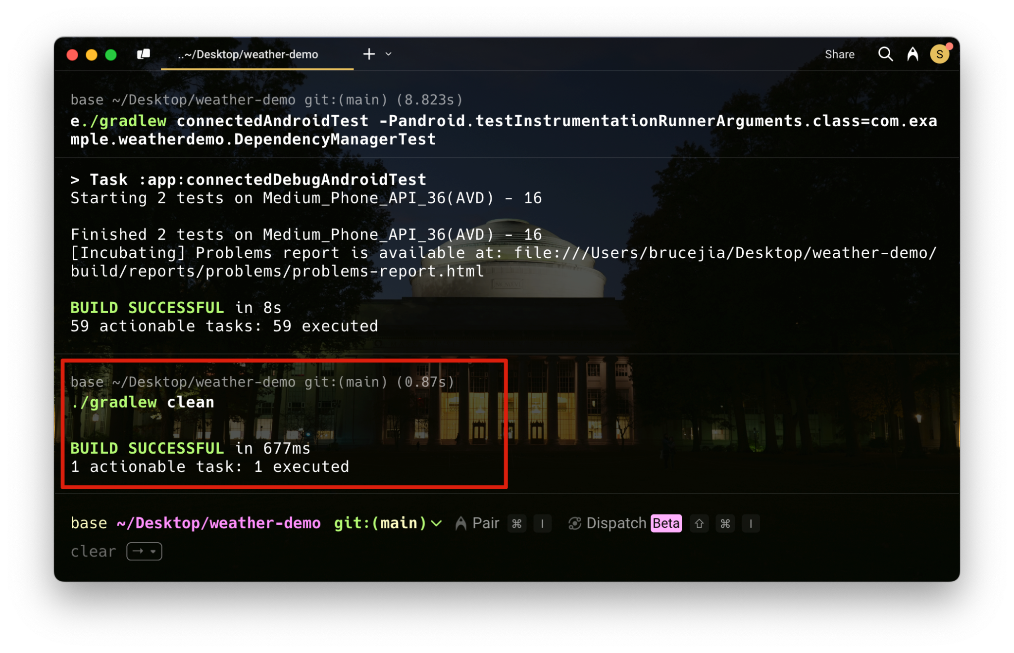
Instrumented Test Class

Slide 43
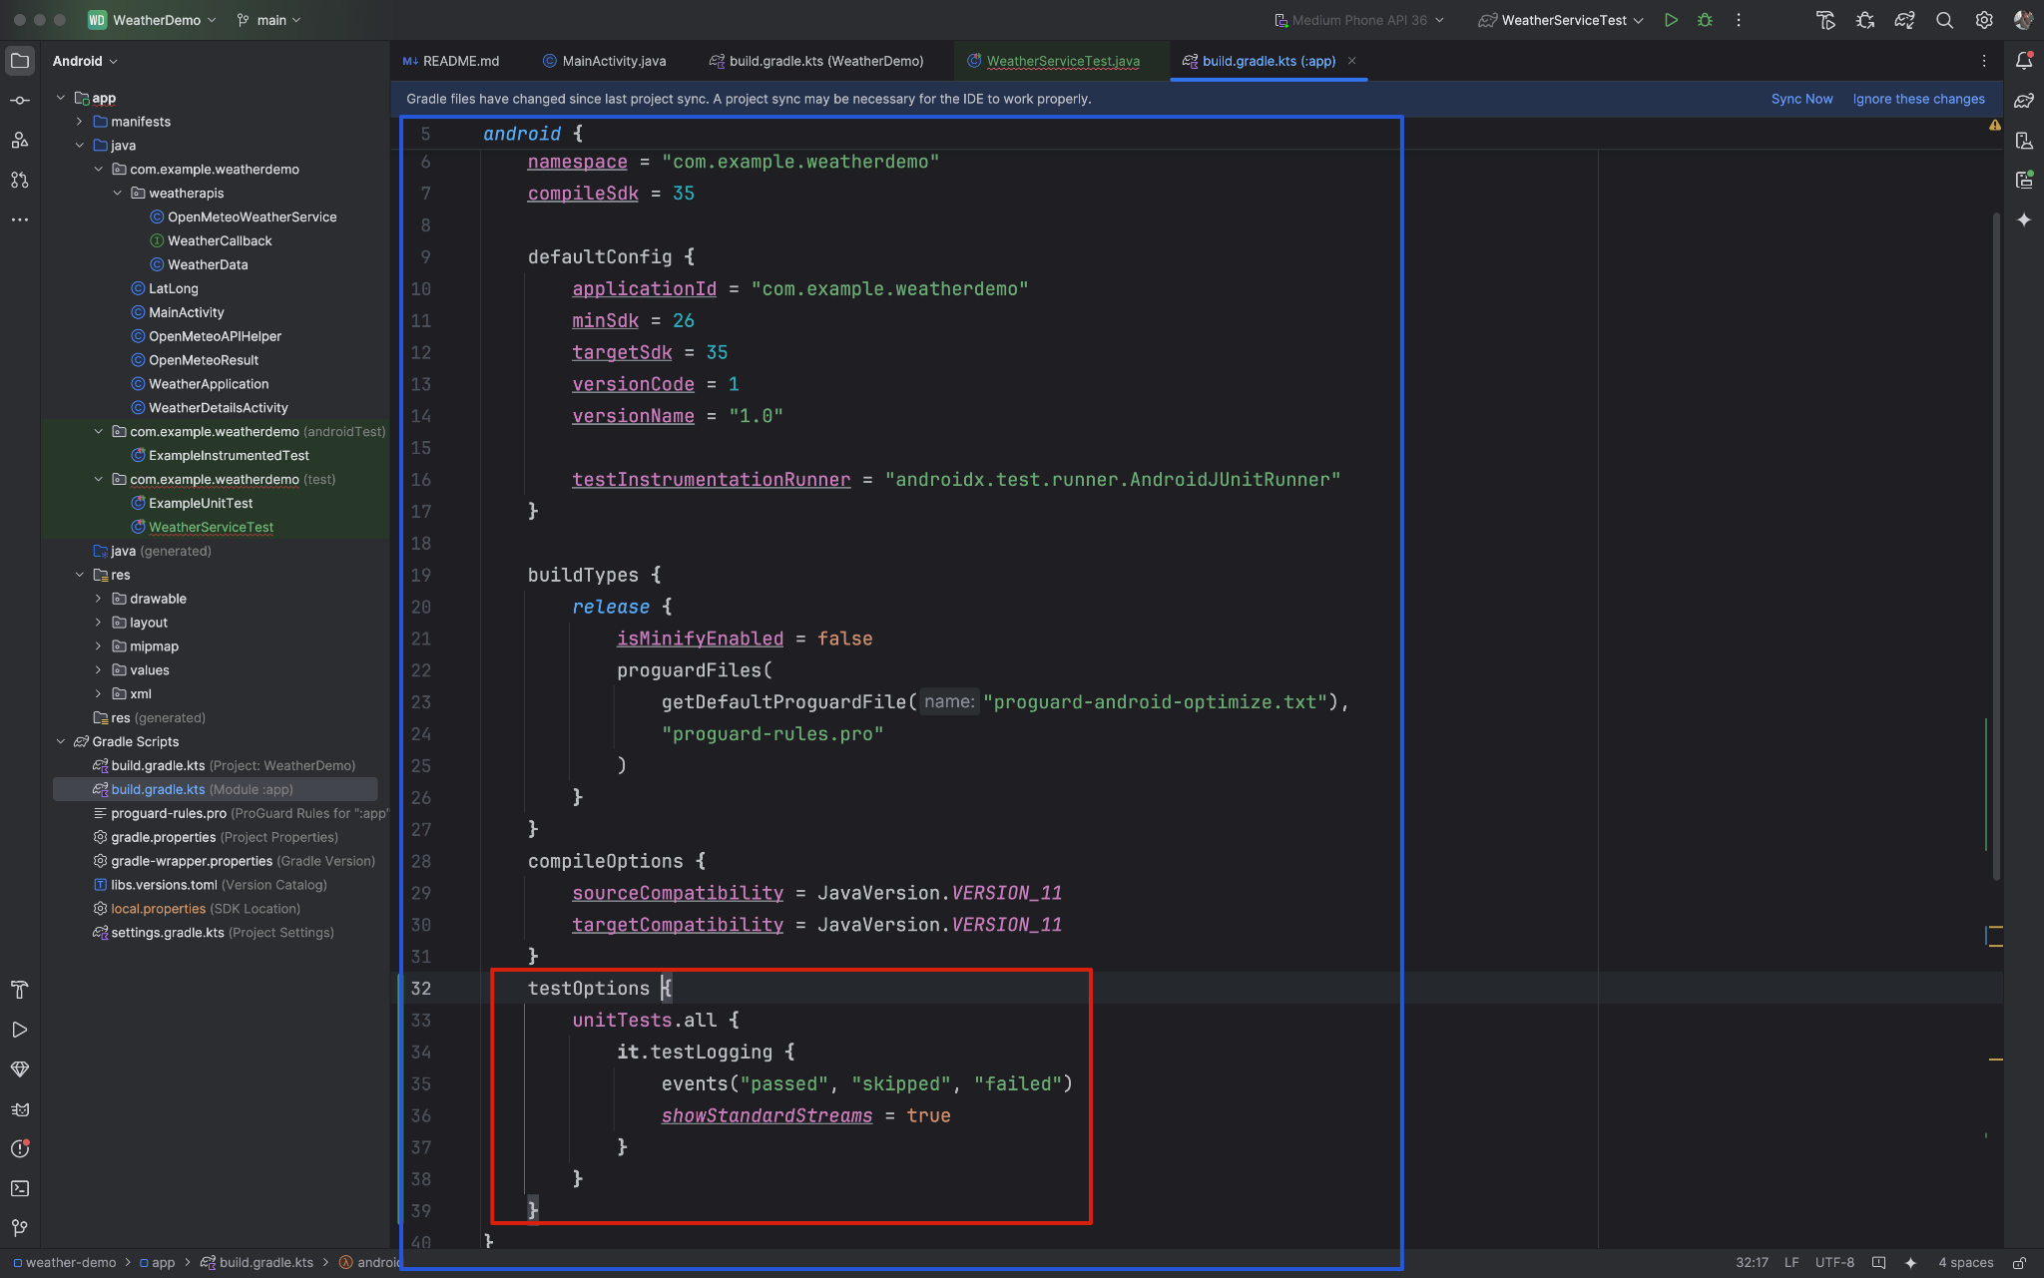
Part 6 ー Weather Demo Unit Testing

Slide 44
Part 6 ー Weather Demo Unit Testing
You can add your testOptions {} inside the android {}
android {
…
testOptions {
unitTests.all {
it.testLogging {
events("passed", "skipped", "failed")
showStandardStreams = true
}
}
}
}

Slide 45
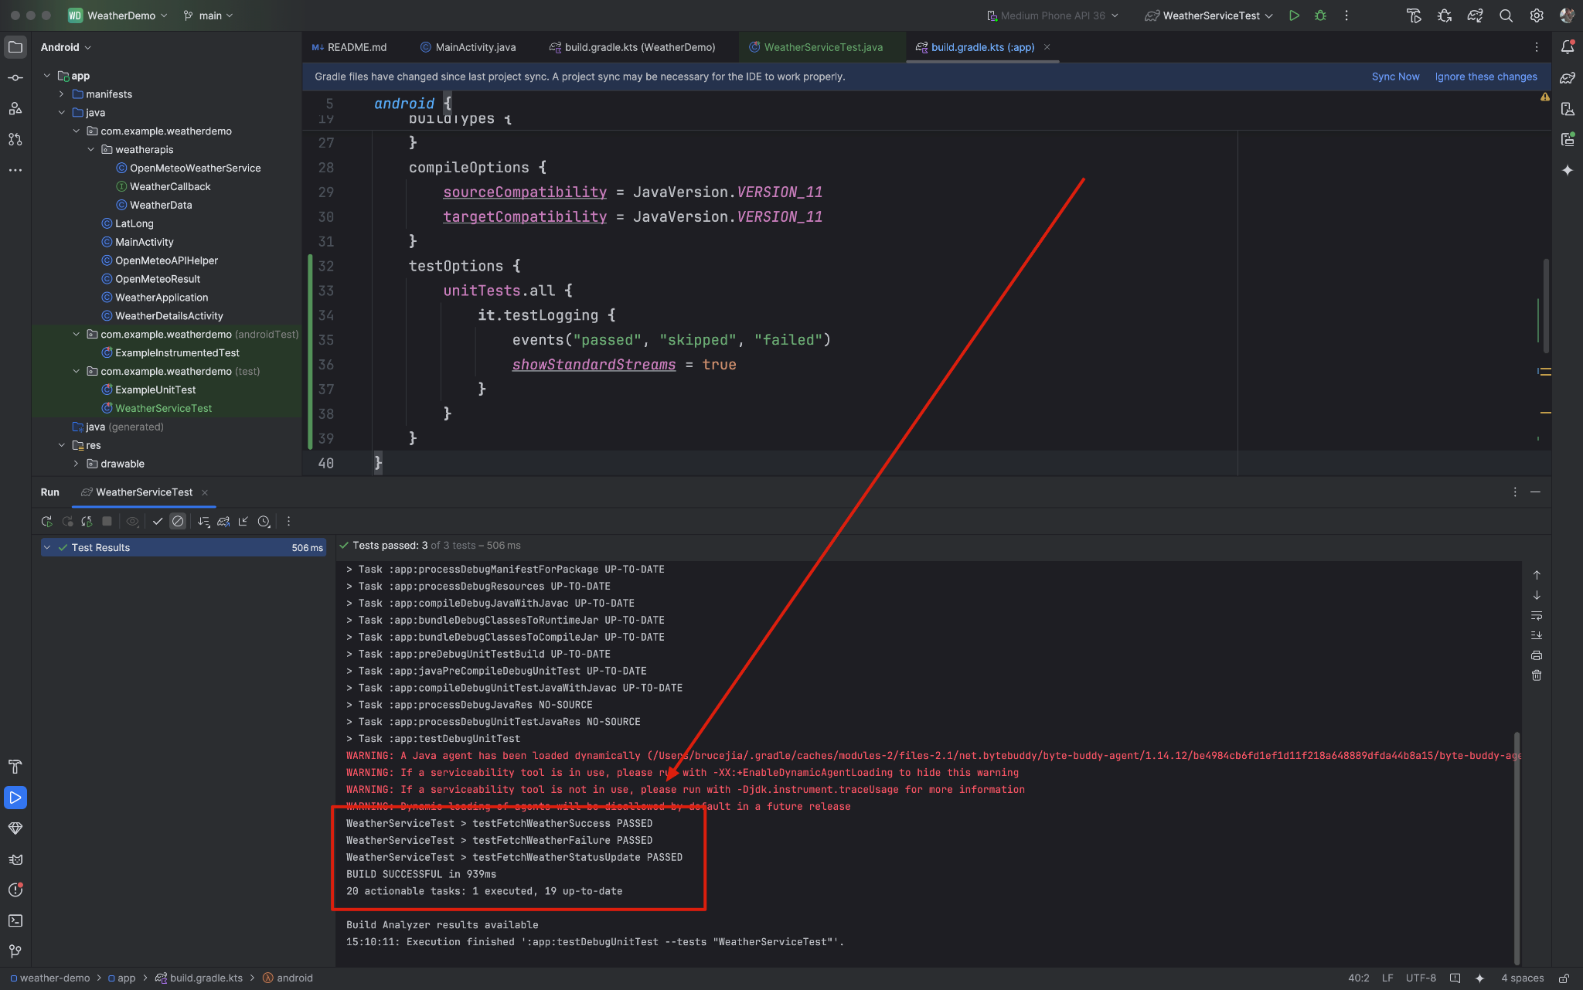
Part 6 ー Weather Demo Unit Testing

Slide 46
Part 7 ー Takeaway
Use Google Test for C++ codes
Use JUnit with Gradle for Android Java/Kotlin codes
Use Android CI with GitHub Actions for Android Testing
Setting Rules on GitHub for code merging
Use Mockito to replace any network, file system, or async behavior with canned responses
Use @RunWith(AndroidJUnit4.class) for Android UI components, Android activity, or Android main thread
Use testOptions for testing event report

Slide 47
Part 7 ー Takeaway (Credits and Links)
Google Test for C++ codes Android-Unit-Testing/tree/main/GoogleTest/tests
Use JUnit with Gradle for Android Java/Kotlin codes [1] Android-Unit-Testing [2] weatherdemo/weatherapis/WeatherAPIServiceTest.java
Use Mockito to replace any network, file system, or async behavior with canned responses weatherdemo/weatherapis/WeatherAPIServiceTest.java
Use @RunWith(AndroidJUnit4.class) for Android UI components, Android activity, or Android main thread weatherdemo/DependencyManagerTest.java
Use testOptions for testing event report weather-demo/blob/main/app/build.gradle.kts

Slide 48
Thank you very much for your attention!

